Slide 1
Winter term 2020/21
Economics I
as a FLIPPED Classroom
Prof. Dr. Peter Schmidt, Fakultät 1 Wirtschaftswissenschaften

Slide 2
/ Flipped Classroom @ Economics: Concept
IN class
Critical discussion of prepared chapters
Additional information (lecturer)
Teams presentations
Application / contemporary topics (DeStat, ECB, OECD: data, articles …)
before class: asynchronous
after class: asynchronous
Book (sub) chapters + ppt + screencasts
(Team-) Homework + texts about current topics (Stiglitz-report, ECG, …)
Team presentations case study about one chapter
during class: synchronous
End of chapter questions from the book
Exercises on book webpage (& AULIS?)
Blogs (wiki ?)
E-Tests: 6 online test every ~ 2 weeks; (5 count for grade)
OUT of class

Slide 3
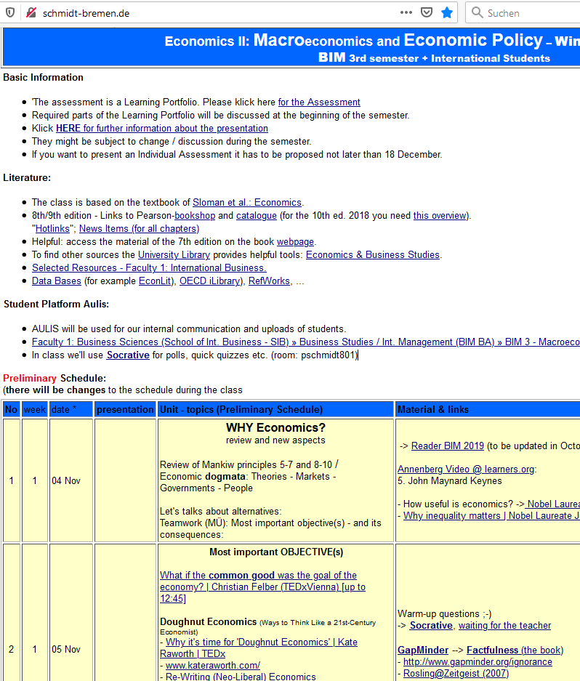
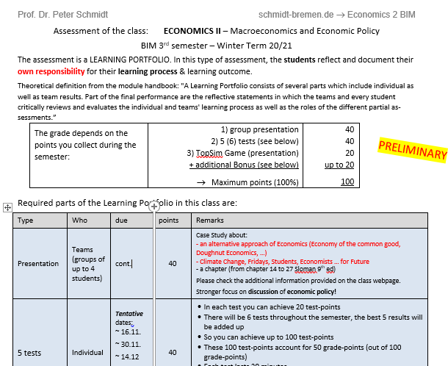
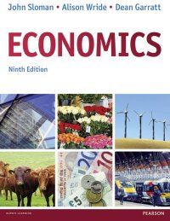
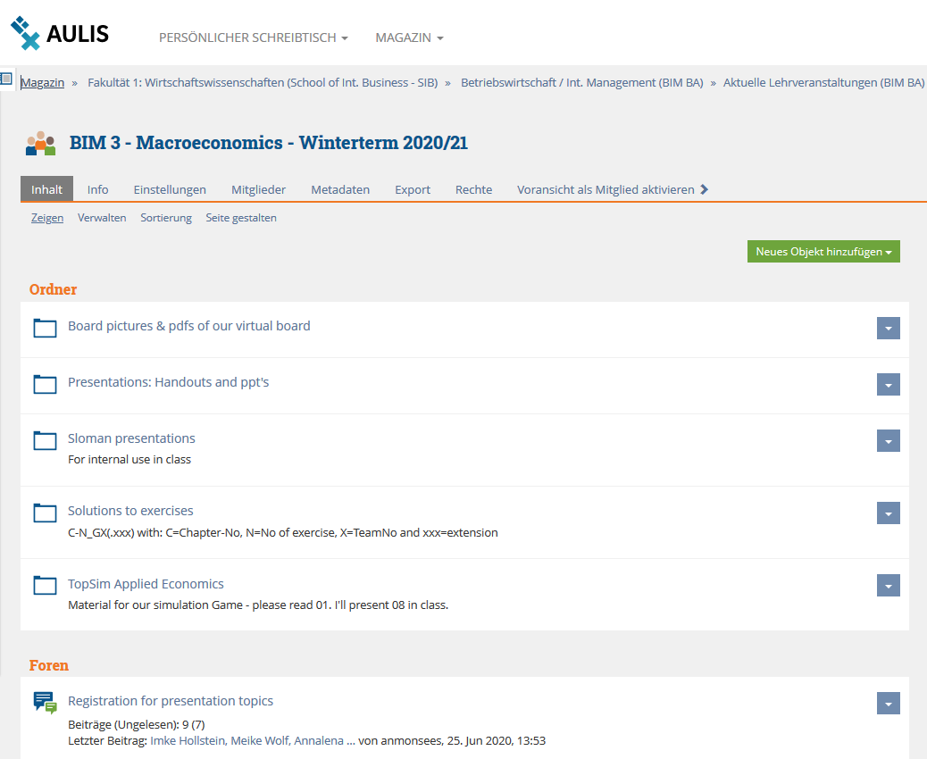
/ Flipped Classroom @ Economics: Communication
1. Webpage -> syllabus, links
2. Literature, documents -> transparency
3. AULIS -> interactive

Slide 4
Looking forward to working with you
Thanks

