Slide 1
Realise Ambitions
At Dublin Business School

Slide 2
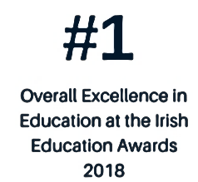
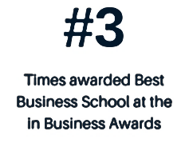
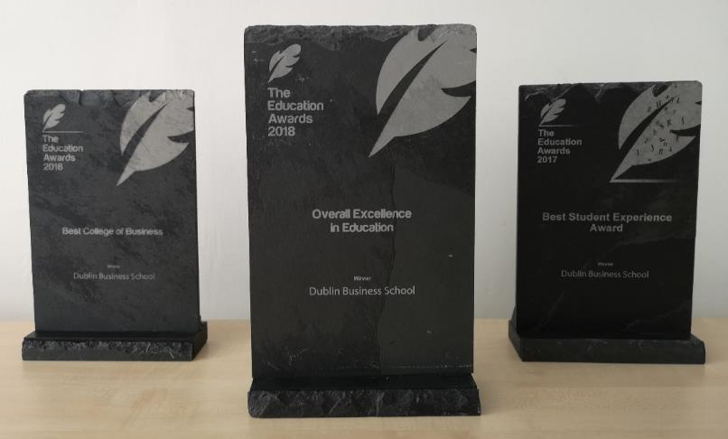
DBS – An Introduction and Overview
City centre location
Career focused
Internationally recognised accreditation
Programmes taught by industry leaders

Slide 3
Dublin Business School
25+ Programmes at Level 8 on NFQ
Some of our programmes:
9 Programmes at Level 7 on NFQ
Creative Media
Psychology
Event Management
Arts
Film
Social Science
HRM
Law
Accounting & Finance
Business
Music Production
Digital Media
Marketing
ICT
20+ Programmes at Level 9 on NFQ

Slide 4
DBS Study Possibilities
PROGRAMMES
Bachelor Degres:
Ordinary (level 7)
Honours (level 8)
Masters Degres:
(Level 9)
Semester Programmes:
UGSEM
Certificates
Year Long Programme (UGSEML)

Slide 5
Direct entry to Year 3
Enter final year of DBS Bachelor (Hons) Degree (Level 8)
Receive the degree award when you complete the year
Intakes: January and September
English requirement: IELTS 6.0/TOEFL IBT 76

Slide 6
Year 3 – BA (Hons) Accounting and Finance
6 modules during the academic year:
Core Modules:
Performance Management
Advanced Financial Management
Financial Reporting
Taxation Systems
Audit and Assurance
Capstone Project

Slide 7
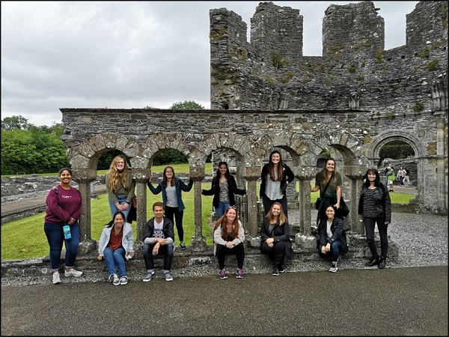
English Language & Culture Course (September only)
Free two weeks English Language and Culture course. Takes place before the Autumn semester begins
Designed for students that don’t meet the English requirement of their chosen programme
Students will sit an English Placement Test at the end of the course

Slide 8
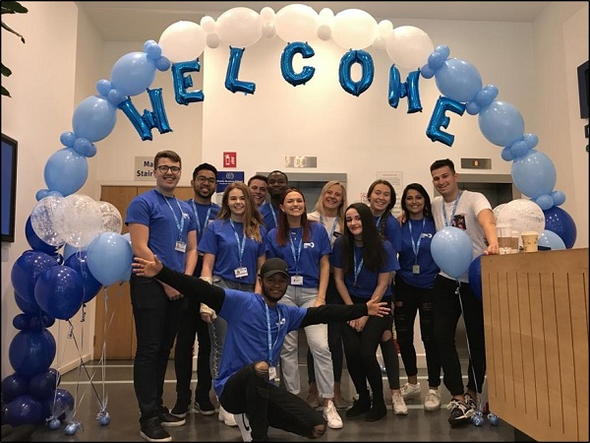
Why choose DBS?
Academic excellence
International study environment
Classroom experience, small groups
Student experience
Student support

Slide 9
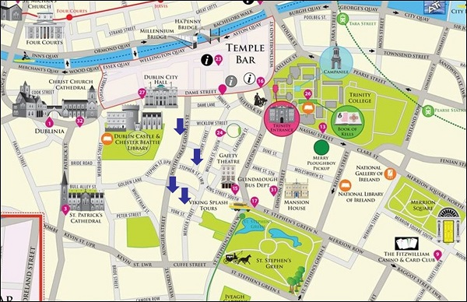
DBS- In the heart of Dublin

Slide 10
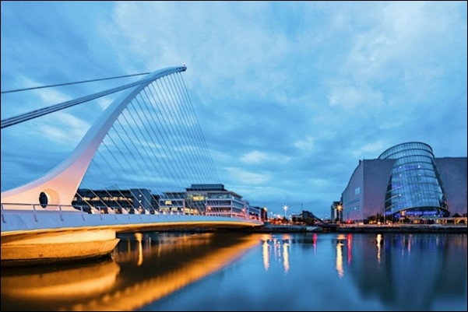
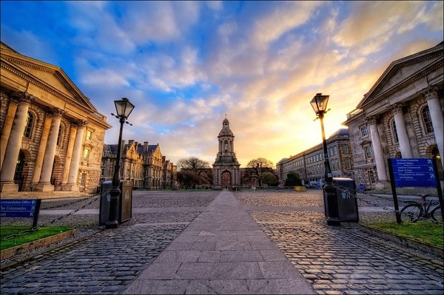
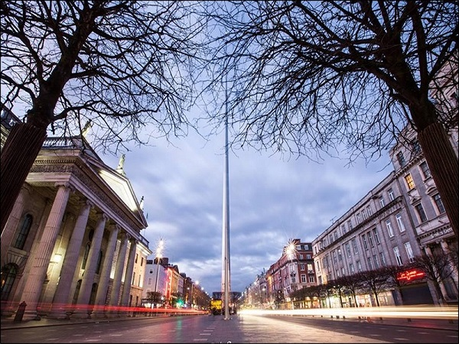
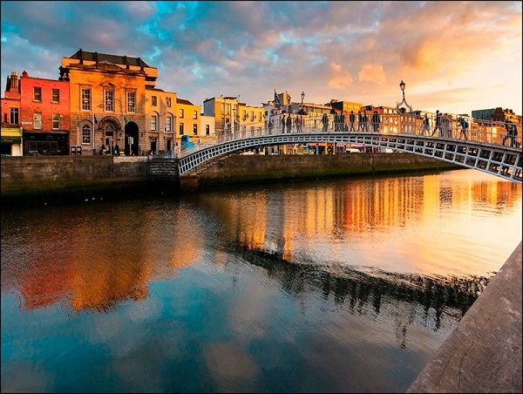

Slide 11
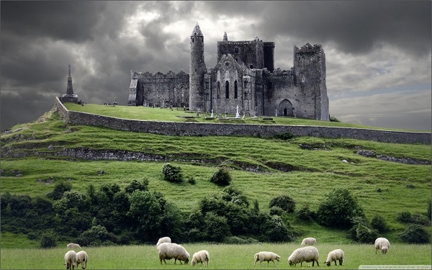
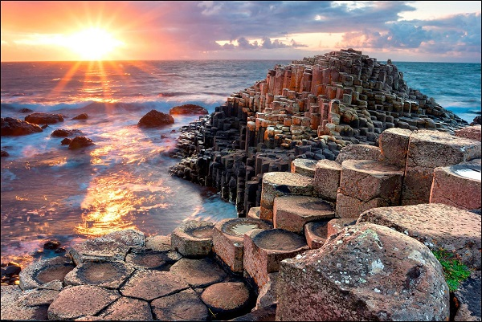
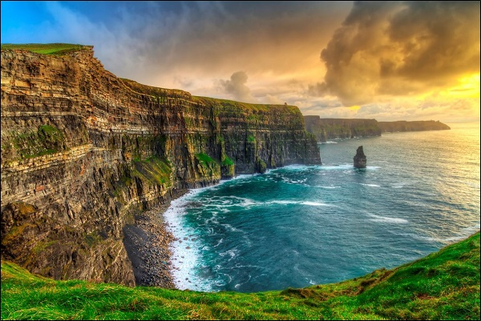
Ireland

Slide 12
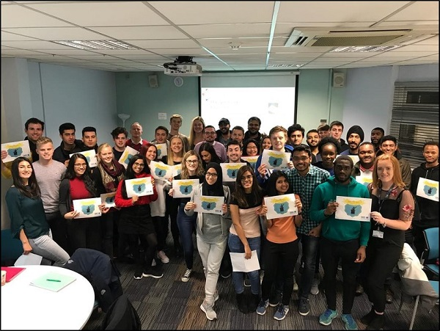
Award Winning Support Services
Student Life Programme – Clubs, Societies, Activities and Social Events
International Student Supports – VISA and Immigration help
Student Welfare - Counselling Referrals & Personal Support – (Private and confidential)
Student Union – Student Leaders helping you each day
Accommodation Guidance – Help in sourcing a place to live

Slide 13
Award Winning Support Services
Peer Mentors – Peer-to-Peer support and guidance
Class Reps – Student representation
First Year Librarian – Helping with your assignments
Expert Careers Support – More to follow
Student Information Resource – All the information you need while in college
Disability & Learning Supports

Slide 14
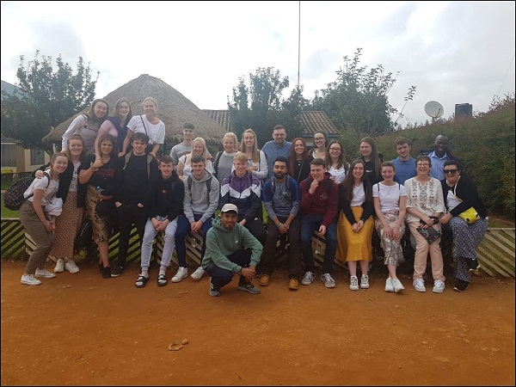
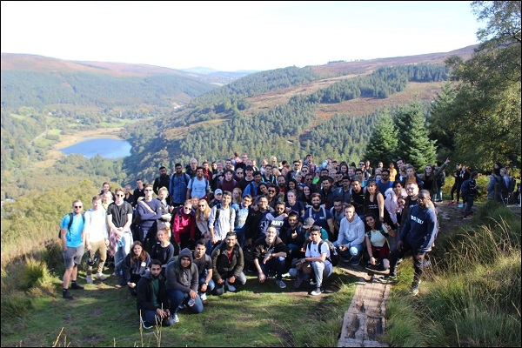
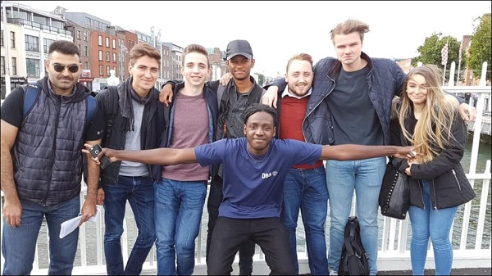
Highlights
Fresher’s Week
Tanzania Programme
Hikings
Student Hiking Trips

Slide 15
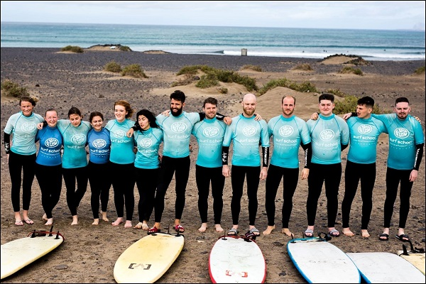
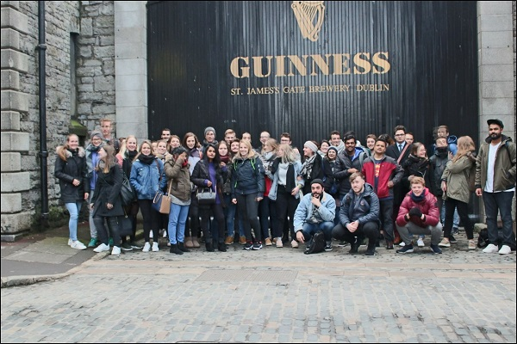
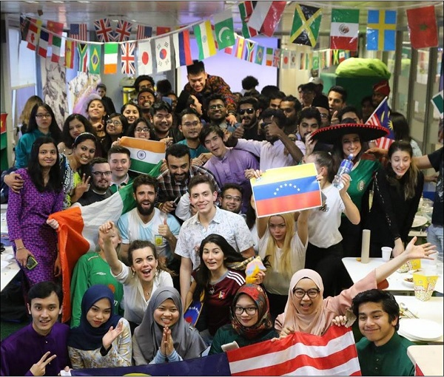
Surf Trip
Cultural activities
International Day

Slide 16
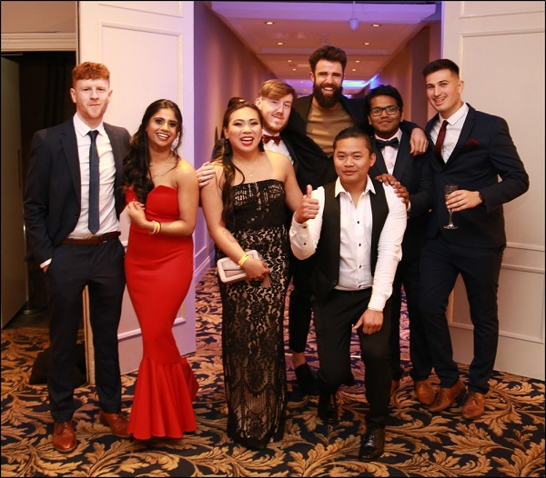
Student Awards Night

Slide 17
DBS – What do the students say?

Slide 18
Follow Student Experience
- DBS Student Experience
- DBS Student Experience
- DBSCollege

Slide 19
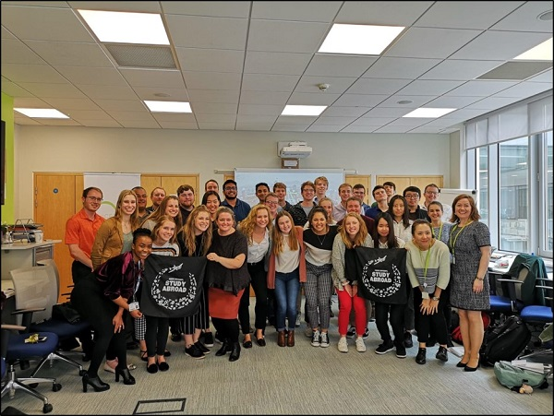
DBS – Careers Department
Helping our students to achieve their career goals and realise their full potential
Weekly on-line and classroom workshops
Internship and placement assistance
Full & Part time – Job search strategies
1 to 1 student meetings and advice
Online job portals
Personal Career Development Weeks
Employability guides
Workplace Visits
Expert industry guest speakers

Slide 20
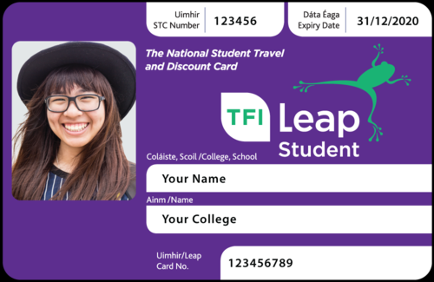
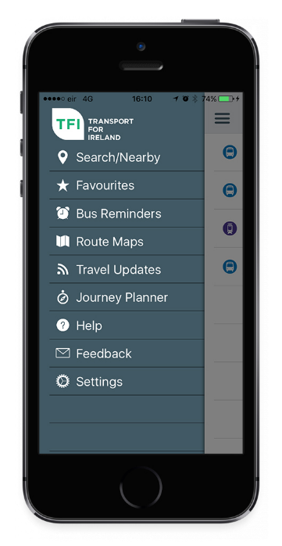
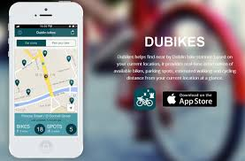
Getting Around
Student Leap Card
Dublin Bus
Dart (Train)
Luas (Tram)
Dublin Bikes

Slide 21
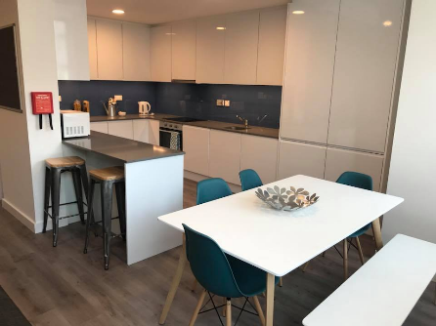
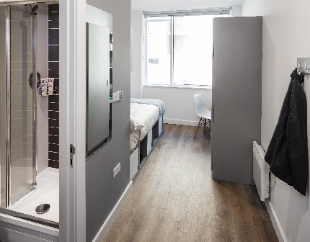
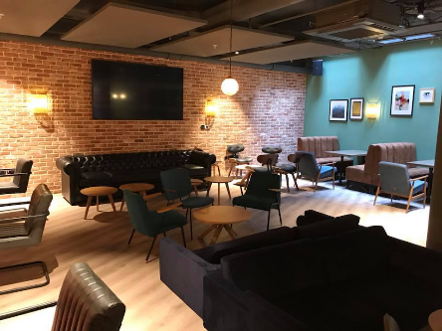
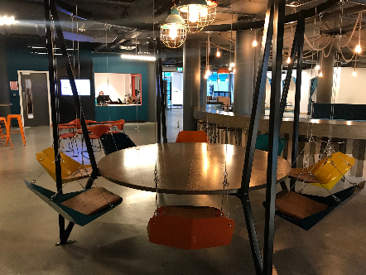
Accommodation Options: Student Residence
DBS has rooms available at Point Campus:
Located 30 min walk /10 mins by tram from DBS
Ensuite single rooms
Common areas (kitchen and living room) shared with 6-8 other students
Facilities include gym, cinema room, study rooms and laundry room
All utilities included in price
€5000/semester regardless of arrival/departure
To book contact student.services@dbs.ie

Slide 22
Accommodation Options: Homestay
Live with a host family in the Dublin suburbs
Single or twin rooms (depending on availability). Shared bathroom
Half- board- breakfast and dinner provided
Located between 45-60 minutes on public transport (bus, tram, train) from DBS
Cost for 4 weeks (maximum stay): €740
To book contact student.services@dbs.ie

Slide 23
Accommodation Options: Private Rental
Rent a room in a shared house or apartment in Dublin city centre or suburbs
Arrive to Dublin early to view and secure rental accommodation
To prevent fraud please view a property in person before handing over any money
Useful links:
www.daft.ie
www.collegecribs.ie
www.hostingpower.ie
www.myhome.ie
www.collegeliving.ie

Slide 24
Dublin – Cost of Living
Estimated Monthly Student Budget:
Accommodation (based on 3/4 people sharing a rented house) | €600 – 900
Bills (Electricity, Heat, Wifi) - (based on 3/4 people sharing) | € 75 – 100
Food | €175 – 225
Study equipment | € 25
Clothes, entertainment and other living expenses | €150 – 300
Transport (depending on type required) | €100 – 125
TOTAL: | €1,125 – 1,675

Slide 25
DBS – Application Process
Step 1: Submit your Application documents
Application form
Proof of identification (passport)
Proof of English:
For Undergraduate programmes – IELTS 6.0/TOEFL 76
For Postgraduate programmes – IELTS 6.5/TOEFL 90
Transcript of academic results up to date
Step 2: Receive your Confirmed/Provisional Offer Letter
Step 3: Send back:
Offer Acceptance Form
Module Selection Form

Slide 26
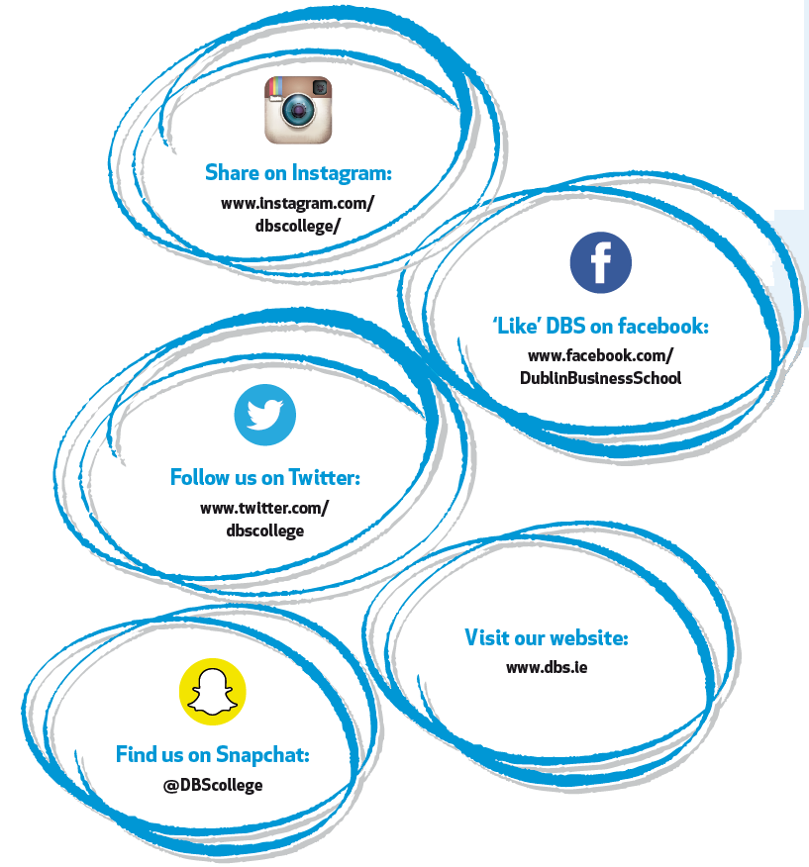
Thank you!
European Admissions
europe@dbs.ie
00353 1 417 7500
Neil Logan (Business Development Manager, Europe)
neil.logan@dbs.ie
Ainoa Zalabardo (Student Recruitment Officer for EU)
ainoa.Zalabardo@dbs.ie

