Slide 1
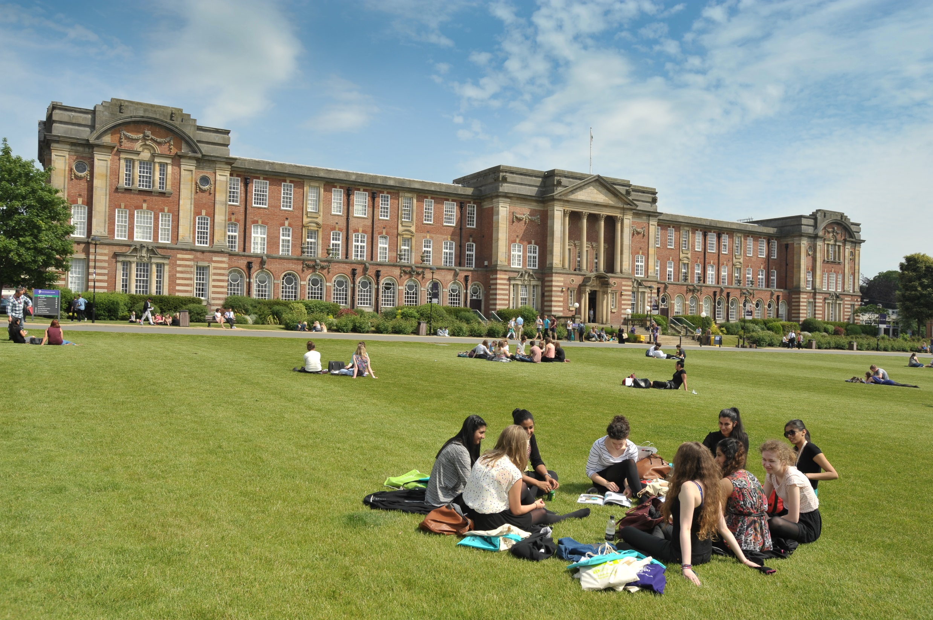
LEEDS BECKETT UNIVERSITY OVERVIEW:
BREMEN HSB
Leeds Beckett University
Stratis Koutsoukos
Course Director BA International Business

Slide 2
Leeds
North of England, half way between London and Edinburgh
Population 790,500
2nd financial centre (after London)
Opera, ballet & theatre
Home to Leeds & Bradford International Airport
Named Britain's best city for quality of life
Three universities, three FE colleges, c. 200,000 students
Home to more than 75 different nationalities
Friendly and welcoming

Slide 3
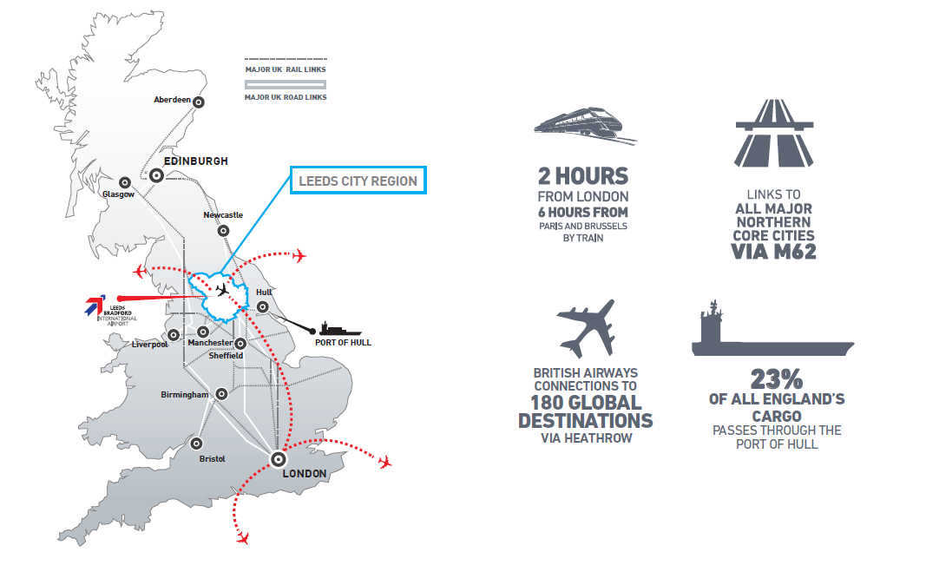
Developing the Northern Powerhouse A critical role for Combined Authorities

Slide 4
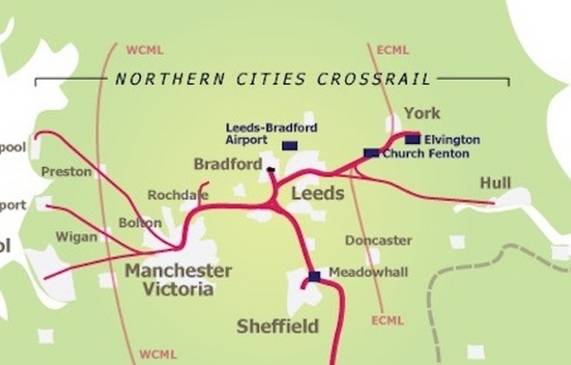
Introduction
Research on LEPS- Local Enterprise Partnerships
Research on Leadership and Local Governance
Research on Combined Authorities and City Regions

Slide 5
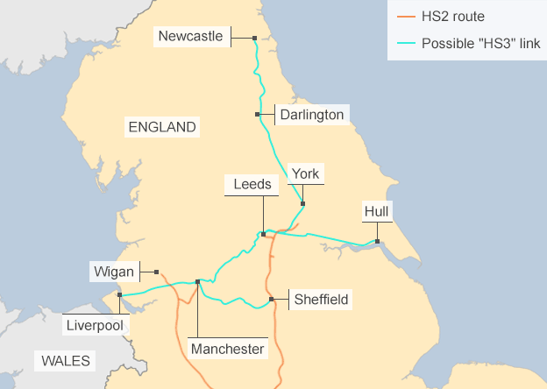

Slide 6
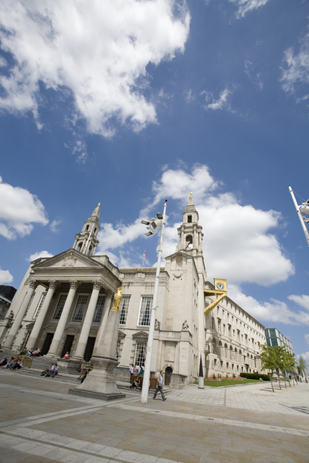
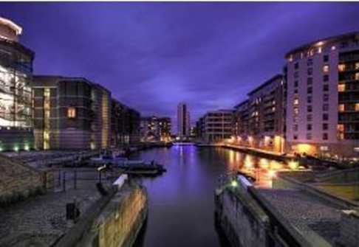
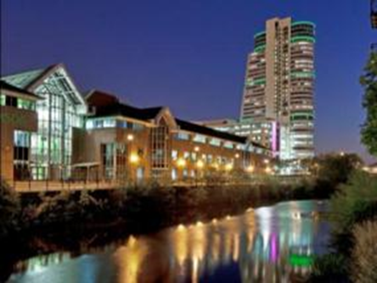
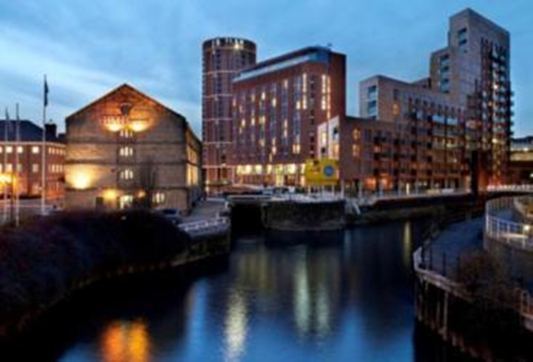
CITY OF LEEDS A GROWING CITY

Slide 7
Leeds Beckett University
Leeds Beckett University
Our history stretches back almost 200 years – Est. 1824
More than 33,000 students study a Leeds Beckett University qualification in the UK and overseas.
Over 2,500 international students
3,000 members of staff (40% academic)
Our diverse community is made up of students from 143 countries and territories
Fantastic facilities, £200m investment in estate
Many of our courses are accredited by professional bodies
96.7% of all our graduates are in work or further study six months after graduating

Slide 8
Recent accolades
Awarded Silver Status in the Teaching Excellence Framework (TEF)
Four Star rating in latest QS rankings (five star rating for employability, facilities, internationalisation and inclusiveness)
Ranked in the Times Higher Education's list of the “top 1,000 universities in the world”
The only university in the UK to hold the Customer Service Excellence standard for our whole institution, underlining our commitment to customer satisfaction
Shortlisted for the Global Teaching Excellence Award 2017, run by the Higher Education Academy (HEA)

Slide 9
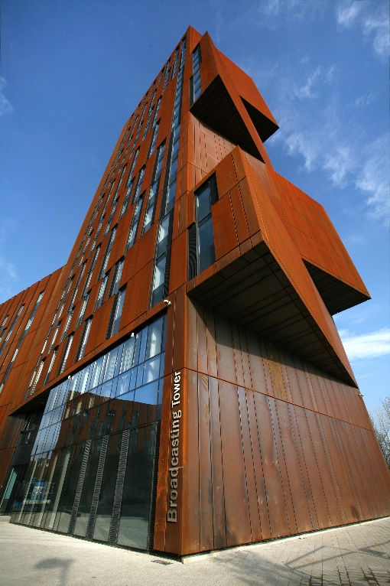
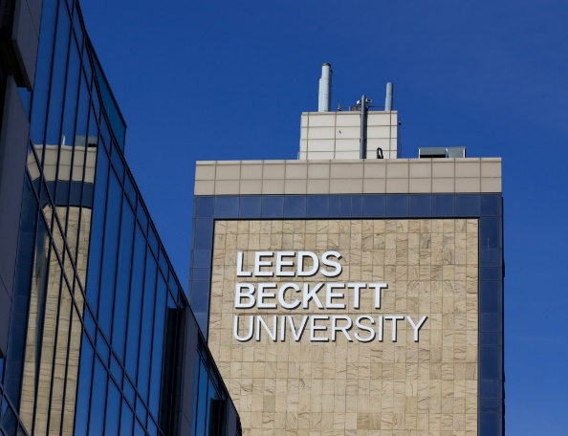
City Campus
In the heart of Leeds City Centre
On the doorstep of hundreds of businesses and organisations that offer work placements and employment opportunities to many of our students
Our Leeds Business School and Leeds Law School are based in the city centre
Home to our state-of-art architecture, film, design and fashion studies.
Specialist health and civil engineering facilities are also based at city campus
In the heart of Leeds City Centre

Slide 10
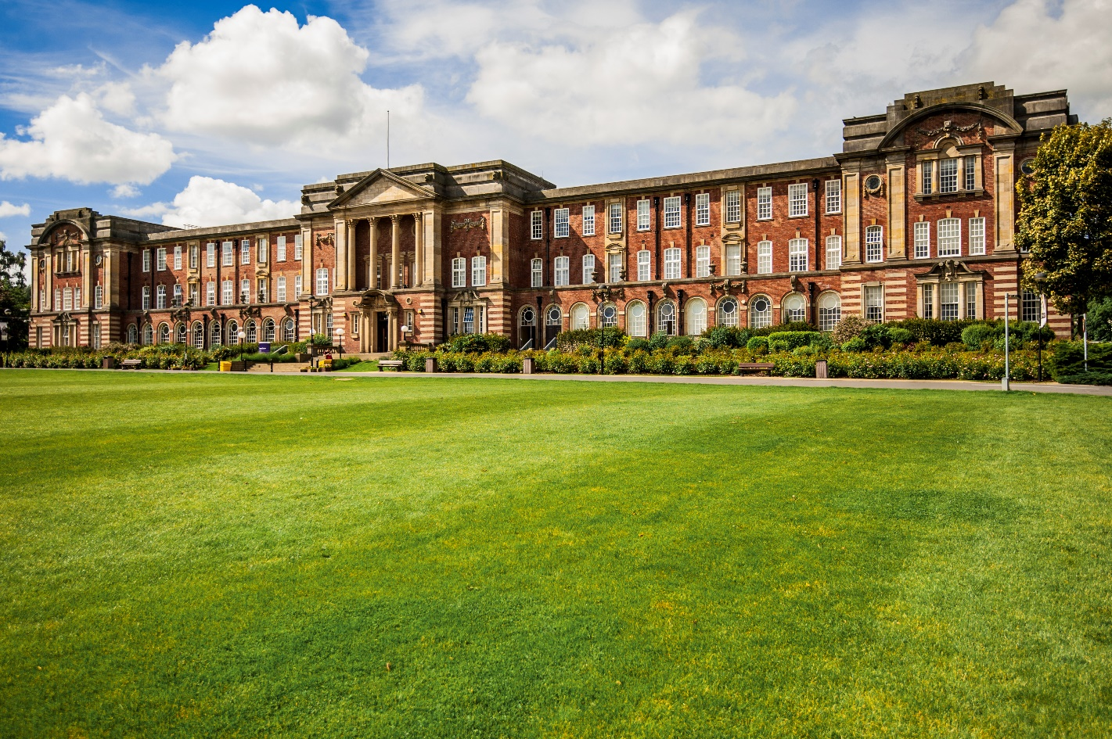
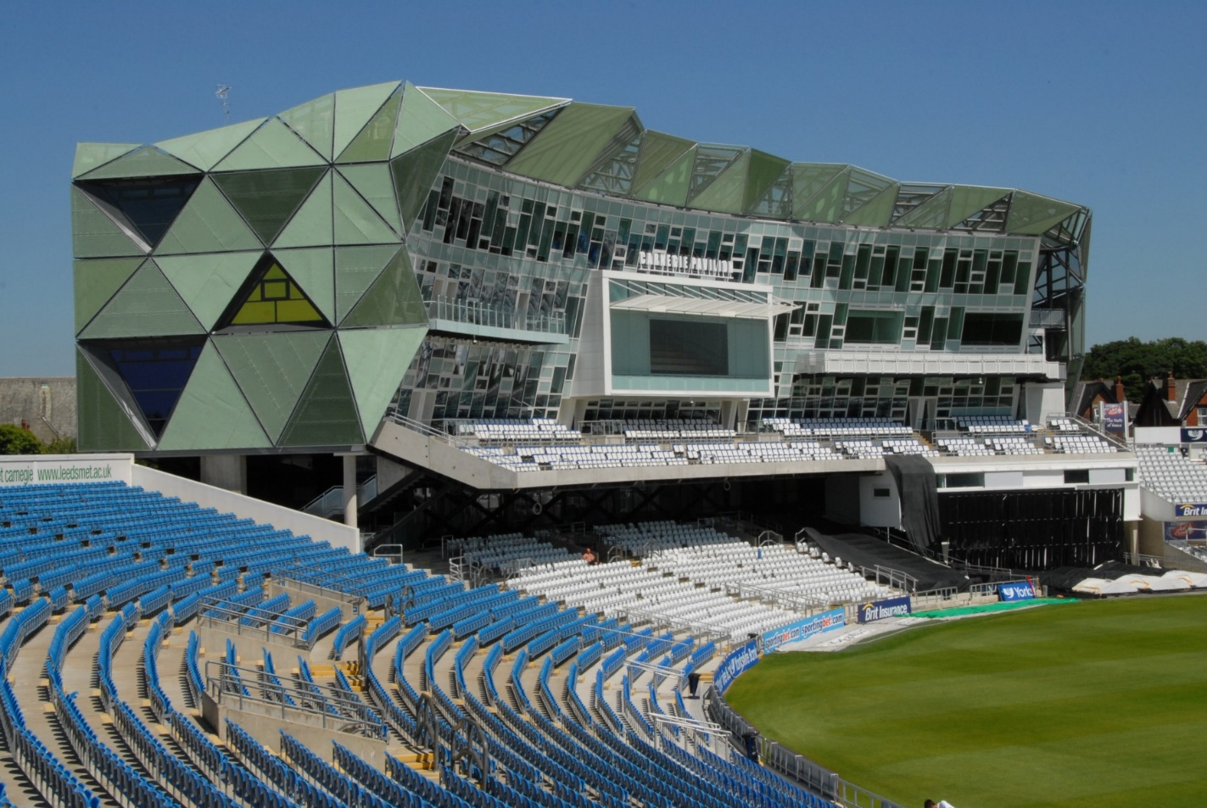
Headingley Campus (1906)
Set in 94 acres of parkland and only 20 minutes to the city centre
Has modern sport science laboratories, animation and music studios and the latest computing labs.
It's where our main sport facilities are based including pitches, inside and outside tennis courts and a running track
Kitchens and catering facilities are based at Carnegie Pavilion for hospitality students

Slide 11
Subject areas include:
Course subjects
Accounting & Finance Architecture & Landscape Design
Art & Design
Biomedical Sciences
Business & Management
Civil Engineering
Computing & Engineering
Creative Technologies
Dietetics & Nutrition
Economics & international Business
Education & Childhood
English, History & Media
Entertainment Management
Environmental Health
Events Management
Film & Performance
Human Resource Management
Law
Law
Marketing & Enterprise
Music
Nursing & Community Studies
Planning, Housing & Human Geography
Politics & International Relations
PR & Journalism
Social & Psychological Sciences
Speech Therapy
Sport
Strategy, Ops & Supply Chain
Surveying, Construction & Project Management
Teaching
Therapeutic & Rehabilitation Sciences
Tourism & Hospitality
More than 200 postgraduate and 140 undergraduate courses across 13 academic schools

Slide 12
Amazing facilities
The University has been given a five-star rating for facilities (QS Stars University Ratings )
Our Library is open 24 hours a day, seven days a week, every day of the year
Ranked 9th in the world and 8th in the UK for sporting facilities ( i-graduate Student Barometer, Autumn Wave 20160
Professional-quality facilities, including; biomedical laboratories, a courtroom, clinical skills suite, financial trading floor, TV studios, fashion and creative arts studios, immersive learning lab (the Hydra Suite), sports science facilities, animation equipment, computer science laboratories and music studios
Prayer rooms on both campuses

Slide 13
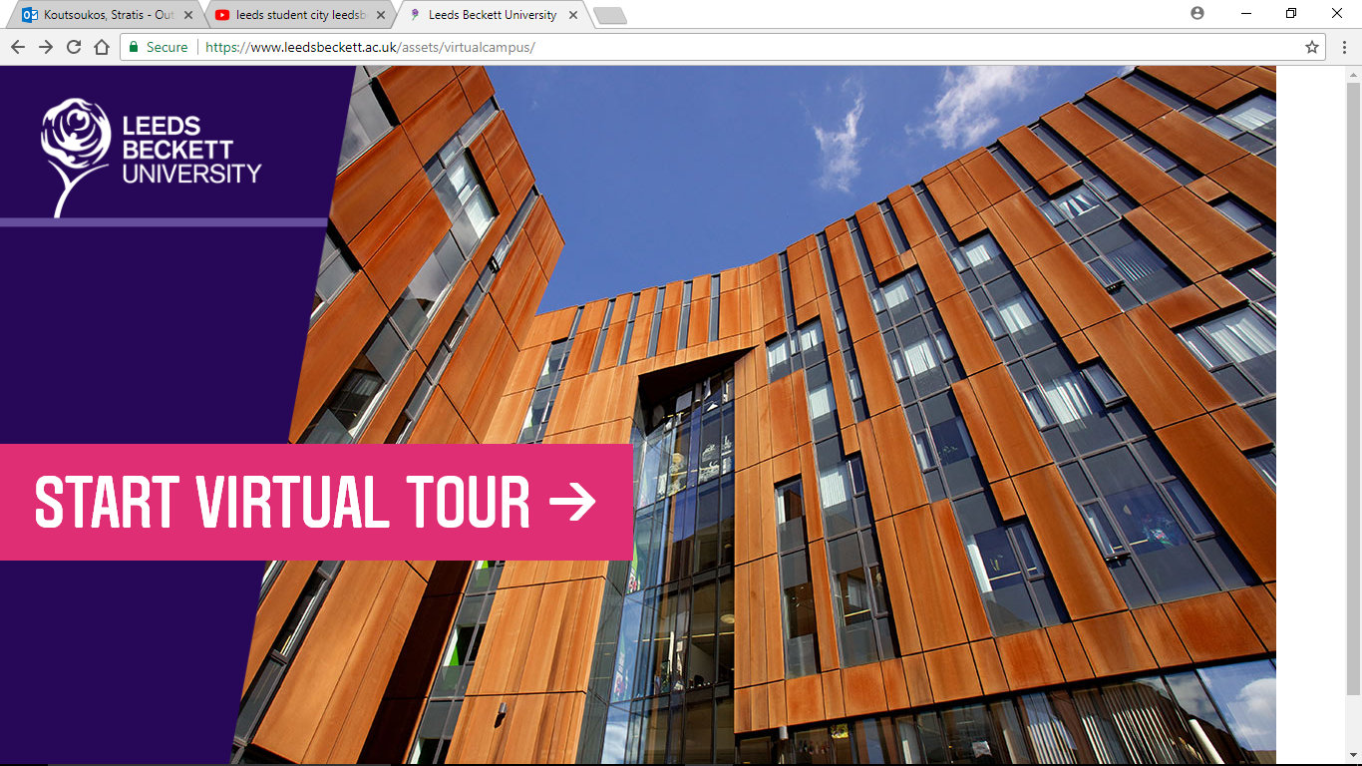
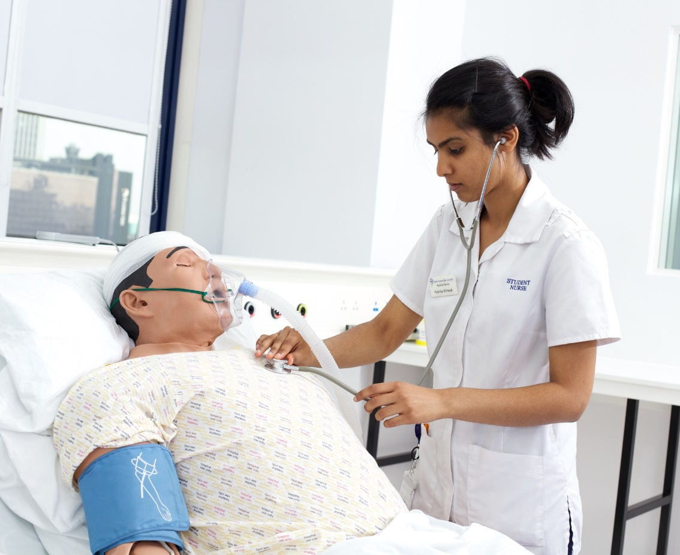
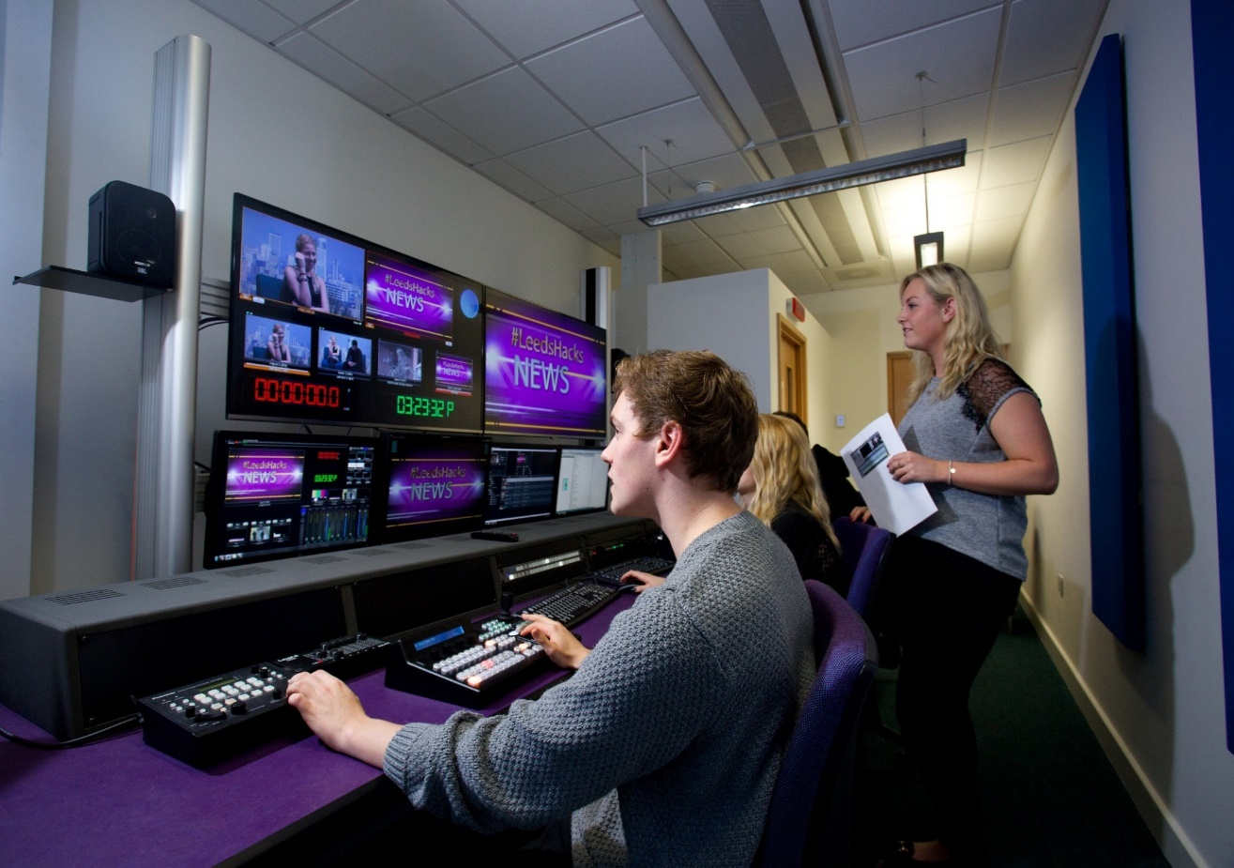
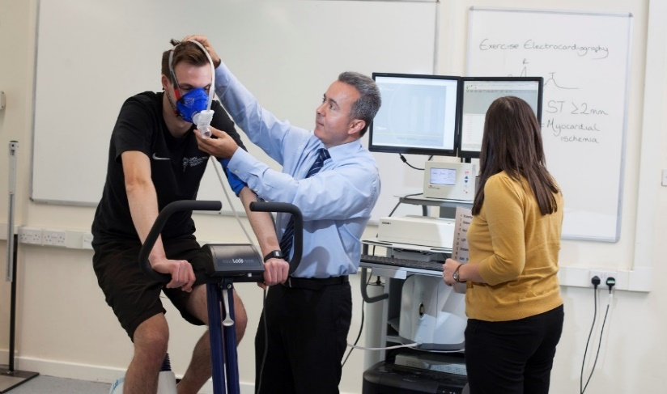
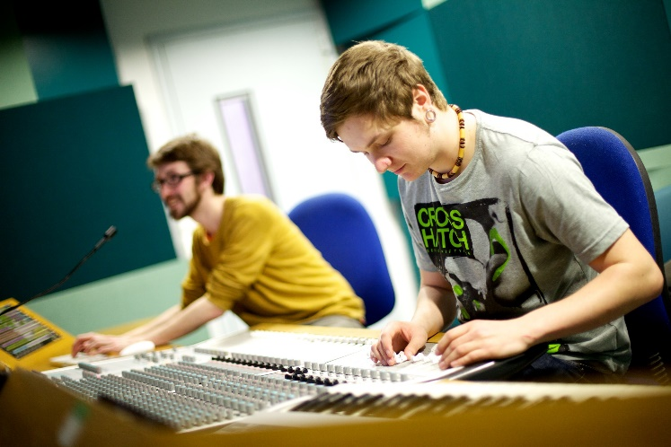
See more of our facilities - www.leedsbeckett.ac.uk/virtualtour

Slide 14
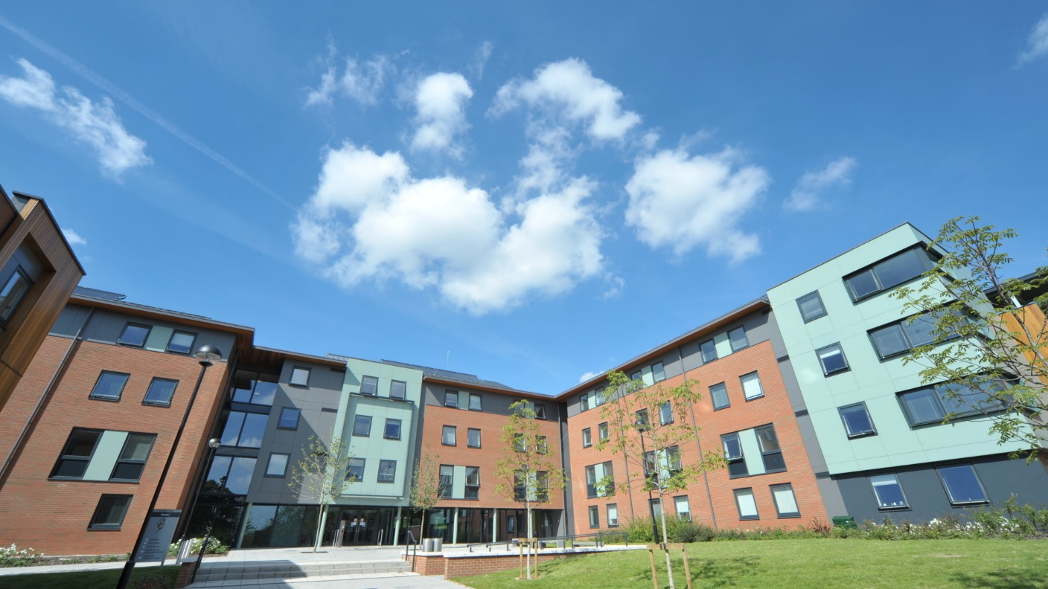
Accommodation
We guarantee accommodation to international students who apply within booking period of 1 February to 31 July
Many students choose to live in halls of residence
Private rented accommodation also available
We match you with like-minded students
All within easy travelling distance of campus, and have free Wi-Fi
Residential officers, responsible for your welfare and pastoral care
Single rooms & private bathrooms available
Connect with people before you arrive on social media via halls of residence Facebook pages
Leeds Beckett University

Slide 15
Tuition fees
Fees & finance
Tuition fees & living costs
Tuition fees will depend on your chosen course and level of study. Typically:
Undergraduate tuition fees: £9,250* / annum
Postgraduate tuition fees: £11,000 - £15,000 / annum
Note: You are expected to pay a minimum of 50 per cent of your tuition fees before you begin your course.
Example living costs / month
As well as paying for your course, you will need to budget for living costs.
Item | Spend (month)
Accommodation | £750
Food | £120
Other Living Costs (Bills, phone, etc) | £145
TOTAL | £1,015

Slide 16
Contact us
Contact details:
internationaloffice@leedsbeckett.ac.uk
+ 44 113 812 2777 / 1111
Social Media
Facebook - www.facebook.com/LeedsBeckettInternational
Twitter - www.twitter.com/Leedsbeckettint
You Tube - www.youtube.com/LeedsBeckettUni
Follow our International Student Ambassadors’ Global Blog about life in Leeds and at Leeds Beckett - www.leedsbeckett.ac.uk/globalblog

Slide 17
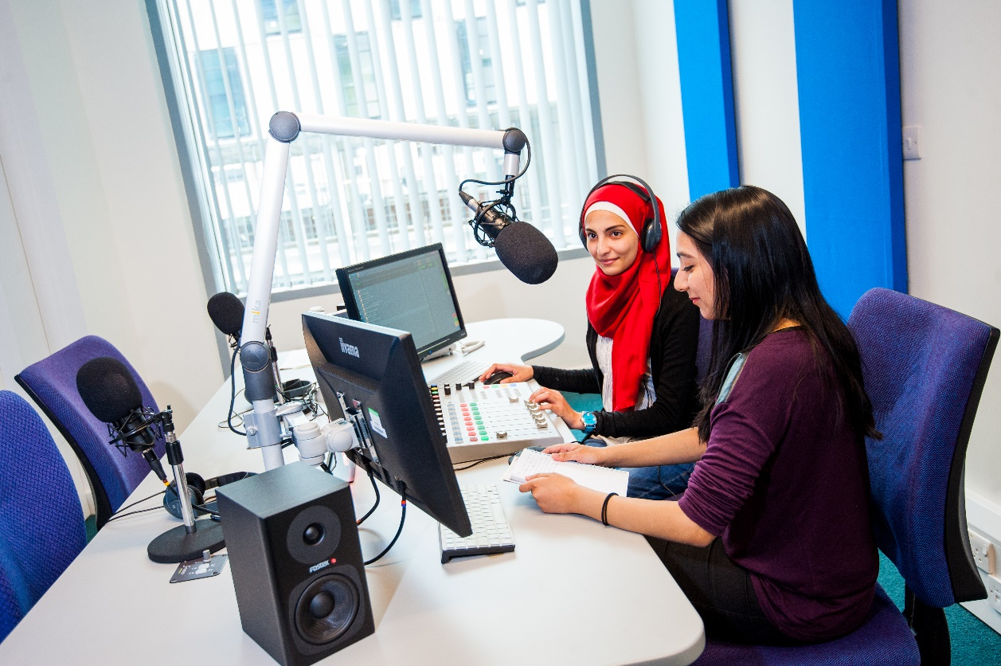
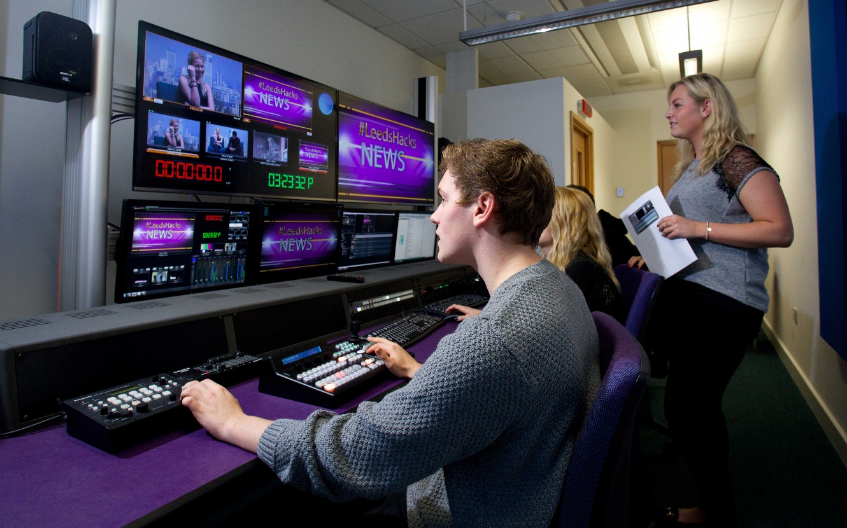
Leeds Business School
7,500 students in the UK & overseas
Over 96% of our students in work or further study following graduation
Awarded Small Business Charter Award
Our retail institute works with leading blue chip companies including M & S, P & G, Waitrose, Associated British Foods
90% of our students are satisfied with their course
Exclusive regional franchise to deliver IOD programmes
Our Public Relations course is ranked fourth in the UK
World class teaching facilities including a full media suite and trading floor with access to Thomson Reuters database
Only Business school in the world using the Hydra suite
Notes:
Images feature students in our Media suite.
Top image is our Radio room
Bottom image features students in our media and tv suite

Slide 18
Leeds Business School
Professional accreditations
ACCA (Approved Learning Partner
CIMA (Chartered Institute of Management Accountants) ICAEW (The Institute of Chartered Accountants – England and Wales)
CMI (Chartered Management Institute)
BJTC (Broadcast Journalism Training Council)
PPA Accredited
CIPR (Recognised Course)
PRCA
CIM (Chartered Institute of Marketing)

Slide 19
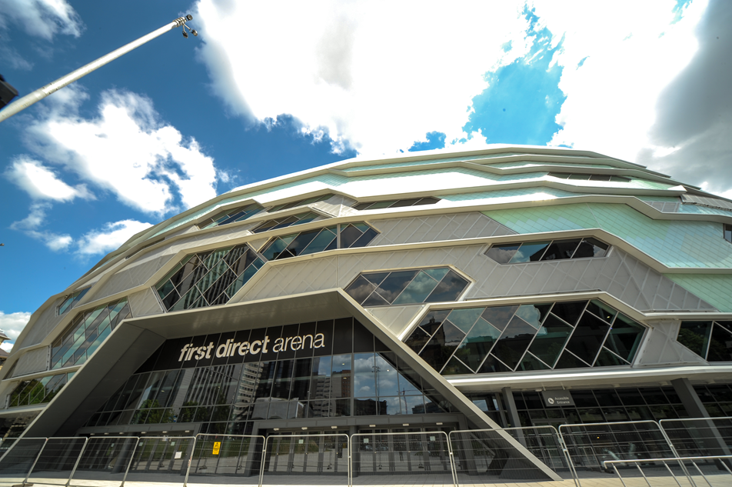
CITY OF LEEDS LEEDS ARENA

Slide 20
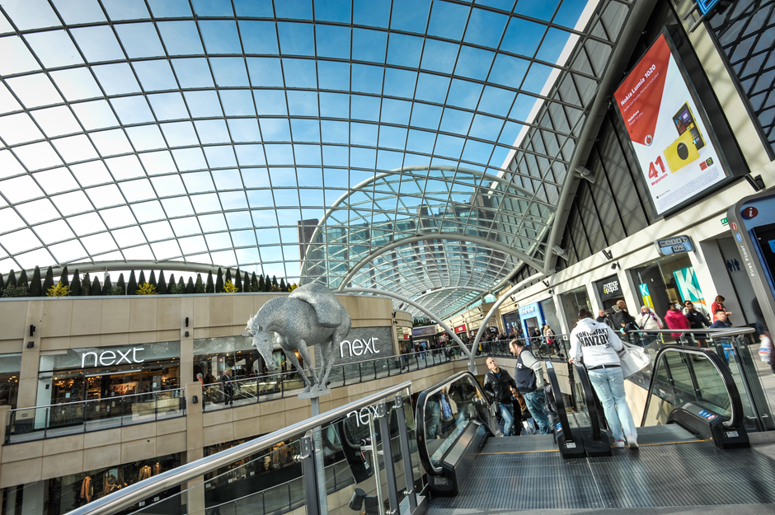
CITY OF LEEDS TRINITY LEEDS
3,000 staff including 1,000 academics

Slide 21
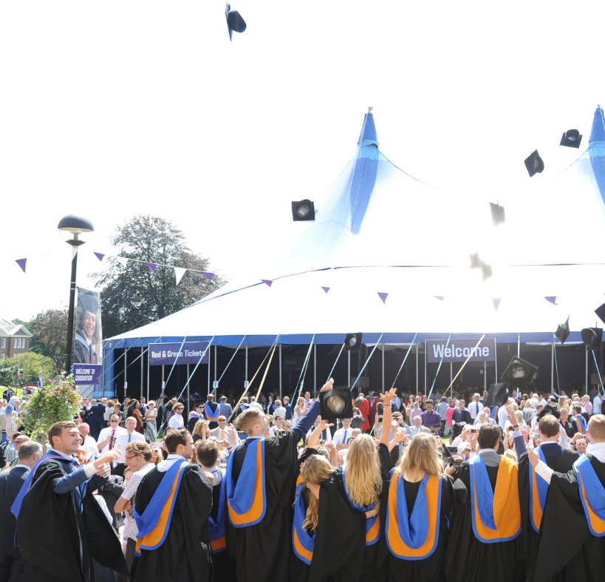
Any questions?
Welcome to Yorkshire (3')
Leeds City Region Leaders (1'30'')
Yorkshire lnguage (3'20")

