Slide 1
ECOLE DE MANAGEMENT DE NORMANDIE
Bachelor in International Management (BMI)
Khaireddine MOUAKHAR
Head of the Bachelor in International Management
BREMEN JANUARY 11TH , 2017

Slide 2
Bachelor in International Management
EM Normandie in brief
4 campuses (3000 students in initial training and continuing education ) in Caen, Le Havre, Paris & Oxford.
Founded in Le Havre in 1871, Ecole de Management de Normandie is one of the oldest established French business schools
67 permanent Lecturers
500 teachers and professionals
More than 200 partner universities in forty countries(exchanges, research, dual degrees)
9 foreign languages ​​taught
500 international students enrolled every year
More than 5000 companies are involved in the school life
Over 500 real projects made ​​by students in companies,..

Slide 3
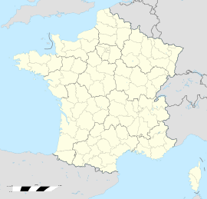
Bachelor INTERNATIONAL BUSINESS based in LE HAVRE CAMPUS
Le Havre : 200 000 inhabitants
https://www.youtube.com/watch?v=jojfFwoN9W8
https://www.youtube.com/watch?v=SwP-9joCkxQ
LH

Slide 4
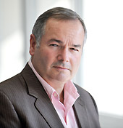
Bachelor in International Management
Governance
Direction
Bachelor Program (BMI)
General Director:
Jean-Guy BERNARD
Head of BMI :
Khaireddine MOUAKHAR
Program Assistants BMI: Emmanuelle BELLET and Coraline LEBUZULLIER
Director of Programs/ Deputy General Director:
Jean-Christophe HAUGUEL

Slide 5
Bachelor in International Management
Year 3 of the Bachelor in International Management
- International Business (taught in English), offered both on the Le Havre and the Caen Campuses. The DD students will be based in LH campus.
FOUNDATION MODULES (SAS)
Marketing
Finance
Law
Excel
French Culture
BUSINESS DEVELOPMENT MODULES
Doing Business in France
Understanding Europe
Multicultural Management
International Development
Business Start up
HRM II
Logistics
CORE BUSINESS MODULES
Business Ethics
Job Research Techniques
HRM1
European Law 1
International Press Review
Financial Analysis
Business Plan
International Trade
International Marketing
CORE COMPETENCE DEVELOPMENT MODULES
Professional Contest / Group Project
Information Management : Databases
Stress Management
Customer / Guest Services Management
FOREIGN LANGUAGE
FL2 / FLE
FL3
+DISSERTATION / INTERNSHIP

Slide 6
Bachelor in International Management
SAS: Introductory Seminar to Management Studies
-A 15 days induction and revision period is scheduled for all students joining the program on the basis of a previous Higher Education Diploma. This program does not generate any ECTS credits (60h). It will take place the 2nd week of September and will last 2weeks.
Marketing : market study, mix-Marketing, … | 15h
Finance : financial statements, annual reports,.. | 15h
European Law : competition law, european committees,… 18h
Excel : | 12h
French Culture : | 6h

Slide 7
Bachelor in International Management
Pedagogical Content BMI3 IB :
 | Semester 1 | Semester 2 | Lecturer | Qualification
CORE BUSINESS MODULES | 90 | 45
Business Ethics |  | 15 | Atif Khan | AQ
Job Research Techniques | 15 |  | Magdalena Kedzior | hors
HRM1 | 15 |  | Aurelian Sofica | AQ
European Law 1 | 15 |  | Hendrik Lohse | AQ
International Press Review | 15 |  | Rupa Raoulx | AQ
Financial Analysis | 15 |  | Dragos Paun | AQ
Business Plan |  | 15 | Torben Sommer | AQ
International Trade |  | 15 | Monica Rivière | AQ
International Marketing | 15 |  | Tibor Mandjak | AQ

Slide 8
Bachelor in International Management
Pedagogical Content BMI3 IB :
 | Semester 1 | Semester 2 | Lecturer | Qualification
BUSINESS DEVELOPMENT MODULES | 60 | 80
Doing Business in France | 20 |  | Anna Fortoul | AQ
Understanding Europe |  | 20 | Maurice Langlois | PQ
Multicultural Management |  | 20 | Diana Santistevan | AQ
International Development |  | 20 | Radu Cocean | AQ
Business Start up | 20 |  | Guillaume Ferrante | AQ
HRM II |  | 20 | Aurelian Sofica | AQ
Logistics | 20 |  | Yann Bouchery | AQ

Slide 9
Bachelor in International Management
Pedagogical Content BMI3 IB :
 | Semester 1 | Semester 2 | Lecturer | Qualification
CORE COMPETENCE DEVELOPMENT MODULES | 30h | 20h
Professional Contest / Group Project |  | 5 | Linh Chi Vo | AQ
Information Management : Databases | 15 |  | Magali Jouen | PQ
Stress Management | 15 |  | Maurice Langlois | PQ
Customer / Guest Services Management |  | 15 | Luisa Souca | AQ
FOREIGN LANGUAGE
LV2 / FLE (*)/LV3 | 15h /Semester
DISSERTATION / INTERNSHIP
TOTAL Hors SAS + FL2
S1: 195h / S2 : 160h
➔

Slide 10
MODULES & SUBJECTS | ECTS
 | Semester 1 | Semester 2
→FOUNDATION MODULES (SAS seminar) | Non Credit Baring
Marketing
Finance
Accounting
Excel
French Culture
→ENVIRONMENT BUSINESS MODULES | 6 | 5
Business Ethics |  | 1
Understanding Europe |  | 2
Job Research Techniques | 2
Multicultural Management |  | 2
International Press Review | 2
European Business Law | 2
→CORE BUSINESS MODULES | 6 | 4
HRM1 | 2
Financial Analysis |  | 2
Business Plan |  | 2
International Trade | 2
International Marketing | 2
→BUSINESS DEVELOPMENT MODULES | 10 | 6
Doing Business in France |  | 4
International Development | 2
Business Start up | 4
HRM II |  | 2
Logistics | 4
→CORE COMPETENCE DEVELOPMENT MODULES | 8 | 5
Professional Contest / Group Project |  | 3
Information Management : Databases | 2
Stress Management | 2
Customer / Guest Services Management | 2
Foreign Language 2 (FL2) or French Foreign Language (FLE) | 2 | 2
Foreign Language 3 (FL3) (*optional) | 2* | 2*
→DISSERTATION / INTERNSHIP |  | 10
ECTS TOTAL without FL3 | 30 | 30
Programs subject to minor modifications.

Slide 11
Bachelor in International Management
DISSERTATION / INTERNSHIP
Pedagogical Content BMI3 IB :
International Students have the choice to do Internship or a dissertation. The french students have to do only the internship. -Dissertation : students will research and produce a 10,000 word academic document on an aspect of European business. Students in simple exchange for one or two semester of the program are not obliged to do internship or dissertation •Dissertation : be able to compile an academic essay containing a review of the relevant literature and an explanation of a specific business issue. •Internship : students should compile a report on a specific management issue or business problem encountered during the internship and a reflection on their performance of work based tasks during the internship
Evaluation of learning outcomes (weightings in %) | DISSERTATION | 100% | Individual Written Report
 | INTERNSHIP | 100% | Report + Presentation + Company Evaluation

Slide 12
Bachelor in International Management
Evaluation Of Competencies And Knowledge:
*How we evaluate a Subject
The evaluation is based on 2 ratings :
continuous assessment (30%)
+
final exam (70%)

Slide 13
Bachelor in International Management
Validation Conditions: MODULE, SEMESTER, YEAR
*How to validate a Module?
- Each module must show an average mark equal to, or in excess of 10/20,
*How to validate a semester?
All the credits for a semester are validated when the average mark for the semester is 10/20 or above
If a module average is below 10/20 the student have to retake all the subjects below 10/20 at the resit session

Slide 14
Bachelor in International Management
Conditions of validation of the Bachelor:
Validation of the year, under condition Internship validation (or Dissertation for International Students)
Semester 1
+
Semester 2
=
60 ECTS

Slide 15
Bachelor in International Management
Re-sits!
The end‐of‐semester Examination Board sets the tests that the student must re‐sit at the next re‐sit exams session (in February for S1 and May for S2) in order to satisfy the conditions required for the validation of the year and degree. The resit grades replace the ones obtained at 1st session.

Slide 16
Bachelor in International Management
Attendance
-No absence is allowed and class attendance is monitored.
-Admittance to Examinations: Students who have recorded over 20% absenteeism per subject (whatever the cause) may be denied entry to the end of semester examination rooms.
Example: Subject (15h) : Maximum (3h)
Absence recorded: (3,5h) ➔ 0/20 ➔ Re-sits

Slide 17
Bachelor in International Management
Internship/Dissertation (main objectif)
•Dissertation : be able to compile an academic essay containing a review of the relevant literature and an explanation of a specific business issue.
•Internship students should compile a report on a specific management issue or business problem encountered during the internship and a reflection on their performance of work based tasks during the internship
WHAT | WHO | WHEN | WHERE | Supervising & Grading
Dissertation | Bremen Students | 15th November the latest | Bremen | Bremen Supervisor
 | Bremen Students | 15th November the latest | EM Normandie | EM Normandie Supervisor
Internship | Bremen Students | 15th November the latest | Bremen | Bremen Supervisor

Slide 18
TO BE ELIGIBLE TO DD AT EM NORMANDIE
Being registered as full time students at the home institution
Have successfully passed all courses and exams at their home institution before studying abroad at the receiving institution.
Have been selected by their home institution to participate in the DD exchange programme
Study at least two academic years at the home institution and at least one academic year at the receiving institution and meet all academic criteria.
Undergraduate students from Hochschule Bremen will study
Semesters 1 and 2 in Bremen (60 ECTS)
Semesters 3 and 4 in Bremen (60 ECTS)
Semesters 5 and 6 at EM Normandie (60 ECTS).
Semester 7 in Bremen, thus obtaining 30 ECTS.
They will also have
Completed a 3month placement in a German or international company
or
Write a professional thesis
Students who meet these conditions and fulfil all requirements will be awarded the state-accredited Bachelor en Management International (BMI) delivered by EM Normandie.
The Bachelor Thesis of Hochschule Bremen will be recognized by EM Normandie if Hochschule Bremen confirms its successful completion.
Diploma ceremony scheduled in march/april
https://www.youtube.com/watch?v=vpyxy_wVnRI

Slide 19
Khaireddine MOUAKHAR: Head of BMI
Le Havre campus:
E-mail : kmouakhar@em-normandie.fr
Tel: 0033 2.32.92.56.78
Fabienne PELTIER : Incoming coordinator Le Havre campus E-mail : fpeltier-mahu@em-normandie.fr
Tel: 0033 2.32.92.52.65
Alexandra LAASRI: International Development Manager Le Havre campus E-mail : alaasri@em-normandie.fr
Tel: 0033 2.32.92.70.88

Slide 20
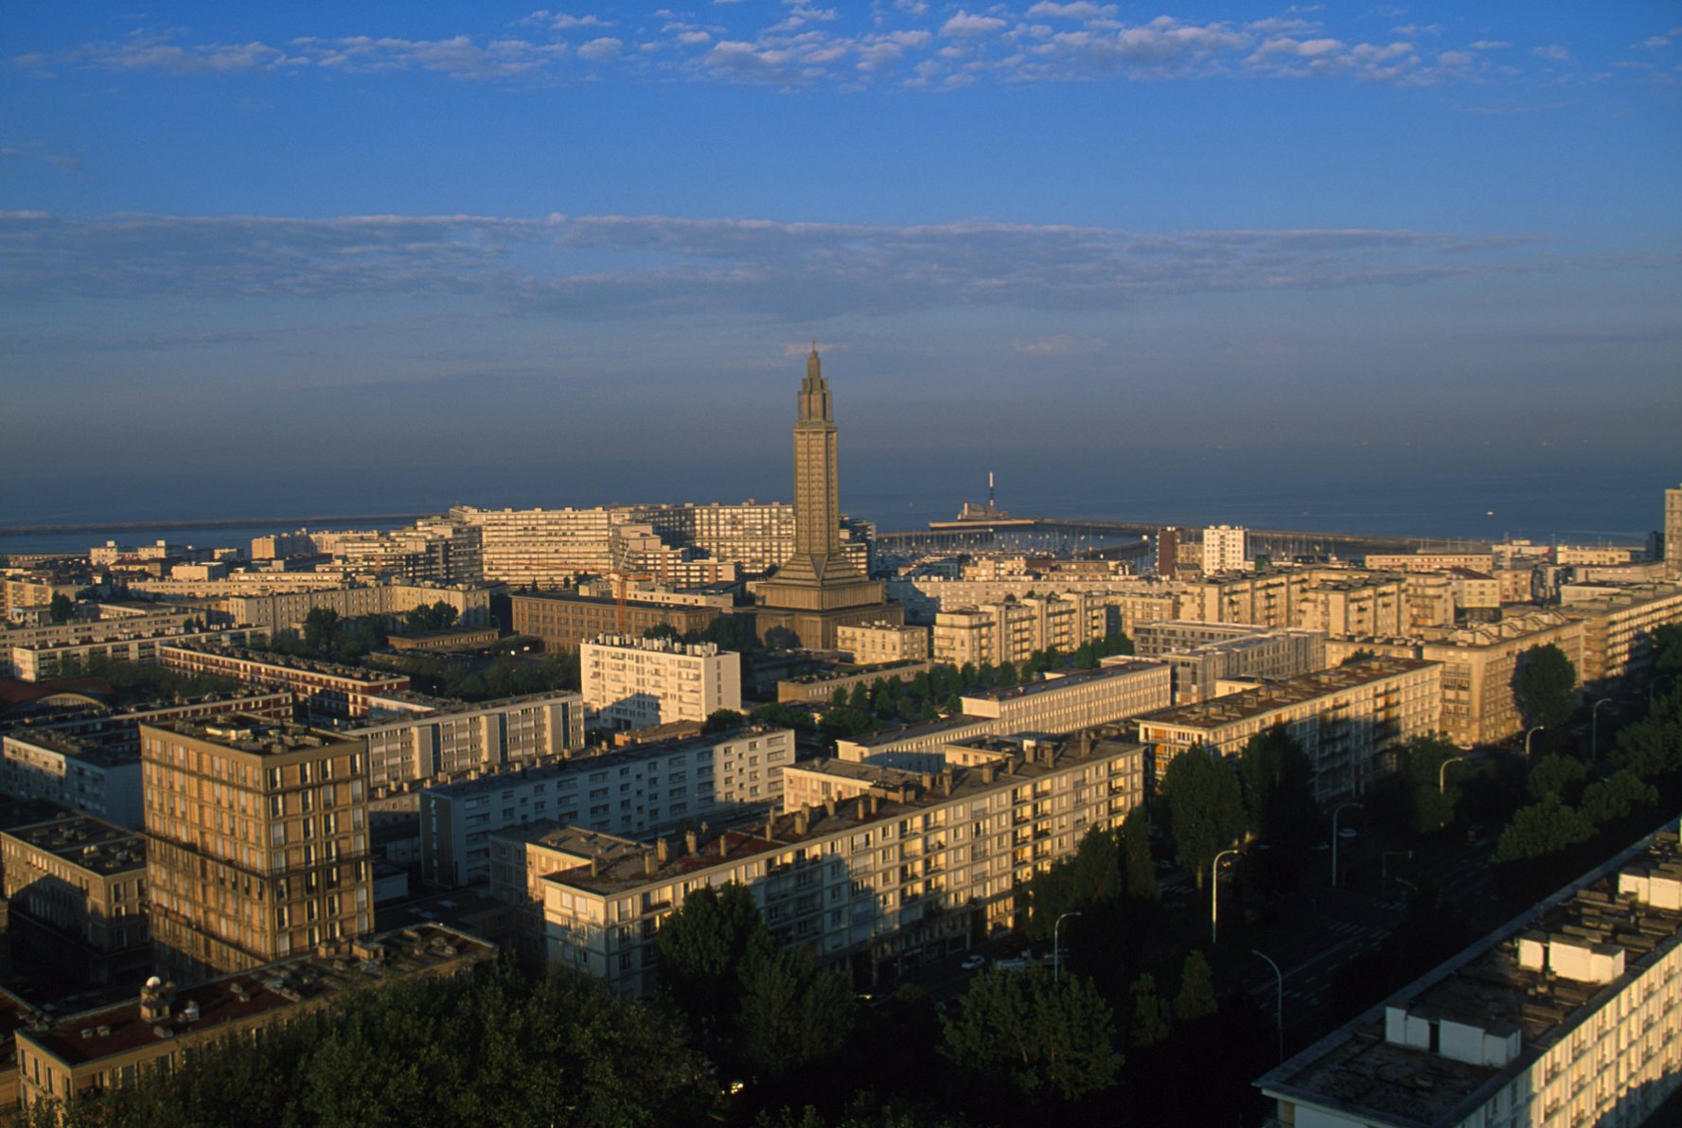
LE HAVRE

Slide 21
LE HAVRE

Slide 22
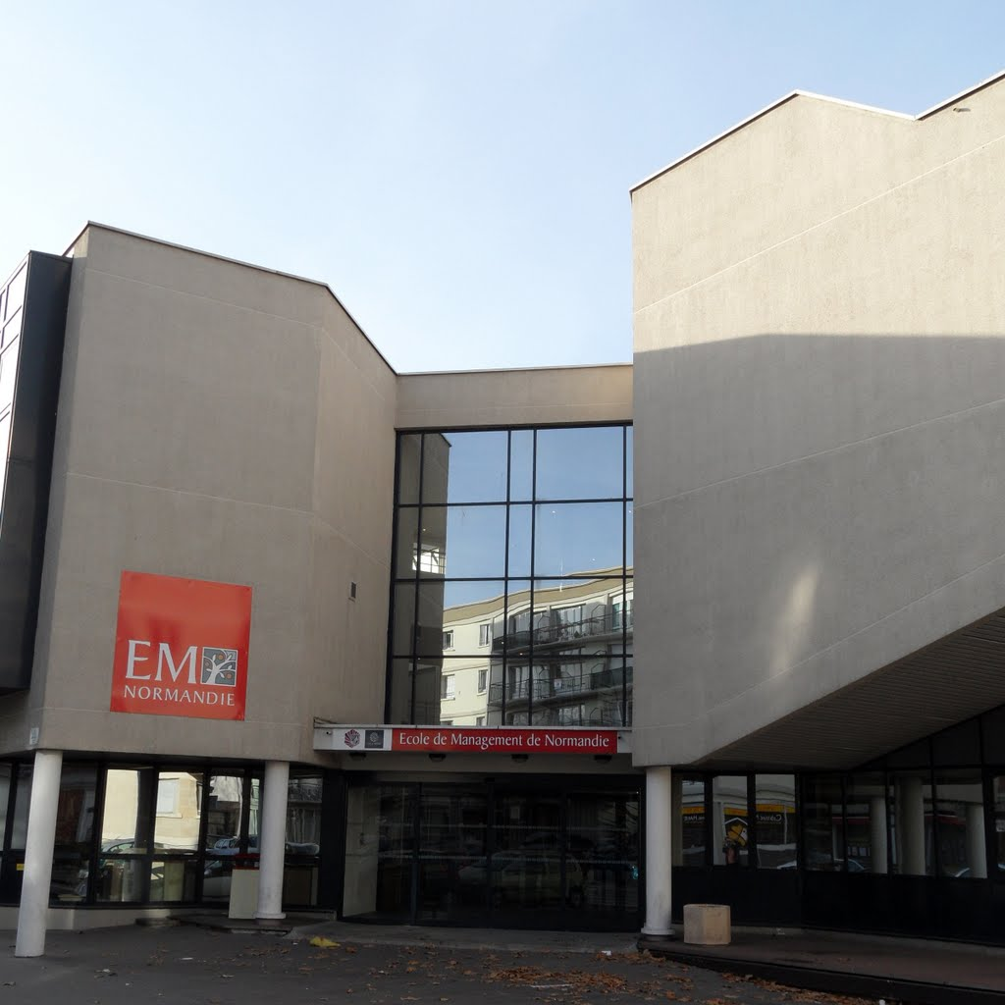
LE HAVRE CAMPUS

Slide 23
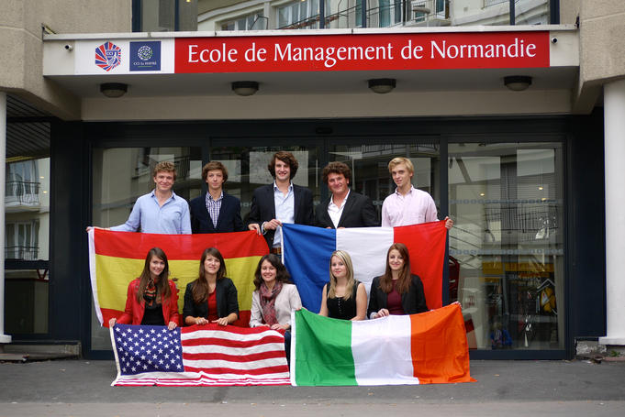
LE HAVRE CAMPUS

Slide 24
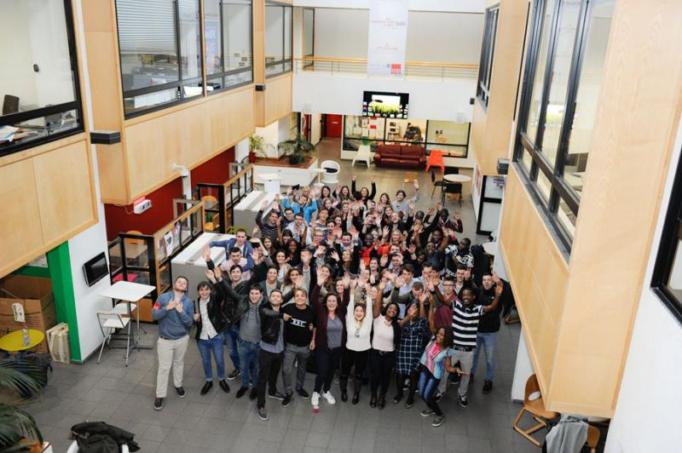
LE HAVRE CAMPUS

Slide 25
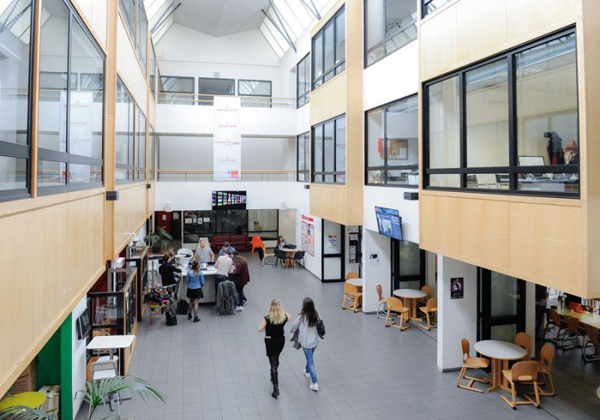
LE HAVRE CAMPUS

Slide 26
LE HAVRE CAMPUS

Slide 27
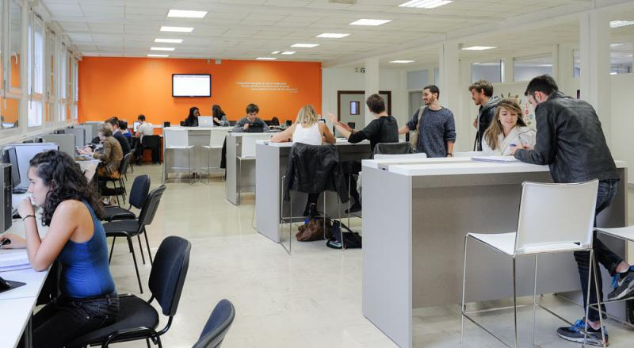
LE HAVRE CAMPUS

Slide 28
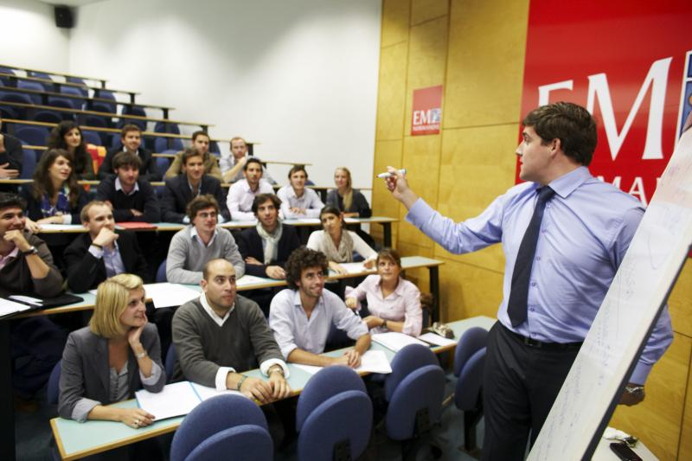
LE HAVRE CAMPUS

Slide 29
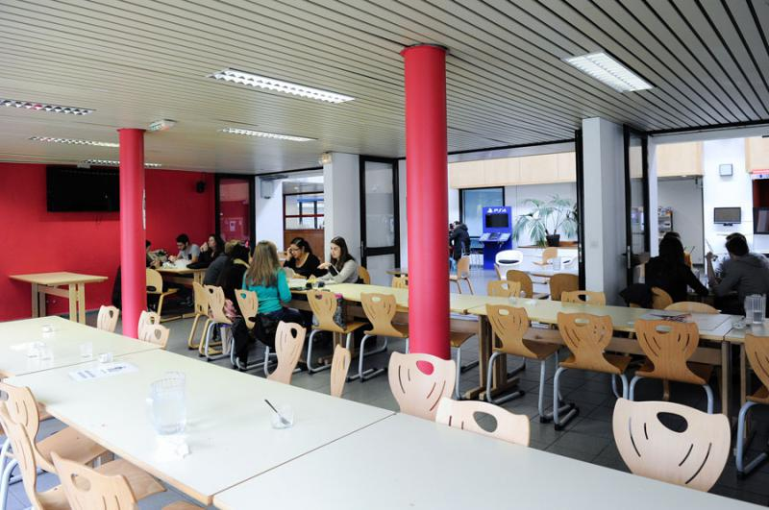
LE HAVRE CAMPUS

Slide 30
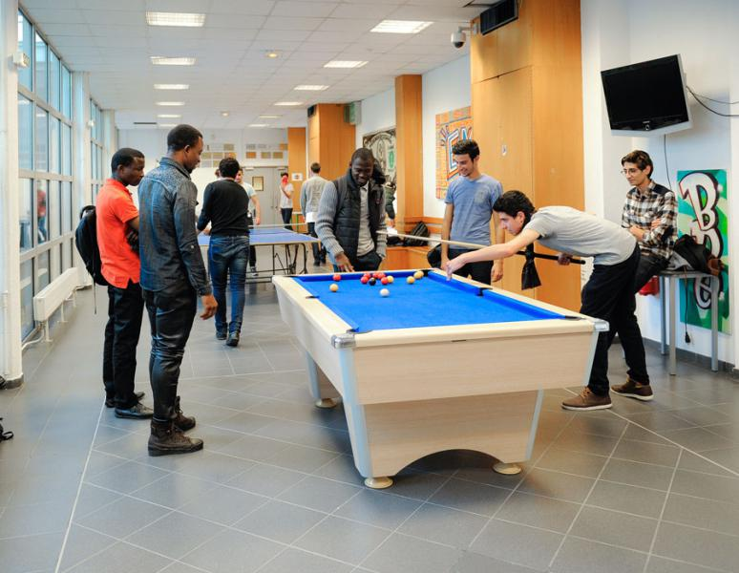
LE HAVRE CAMPUS

Slide 31
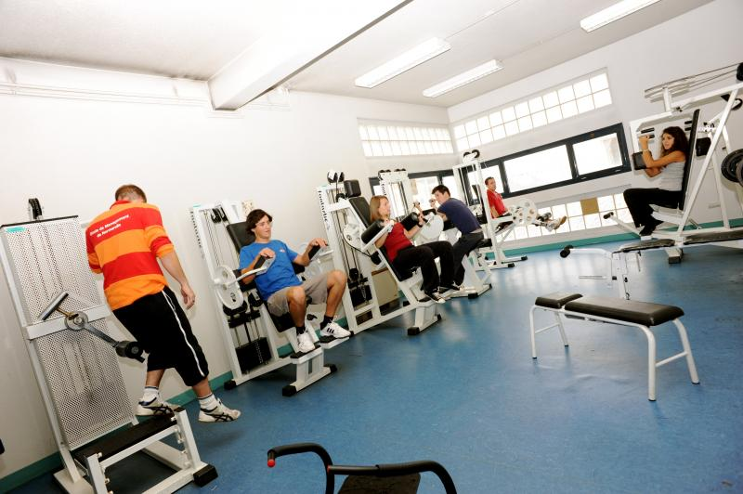
LE HAVRE CAMPUS

Slide 32
LE HAVRE CAMPUS

Slide 33
DANKE ☺
DO YOU HAVE QUESTIONS?

