Slide 1
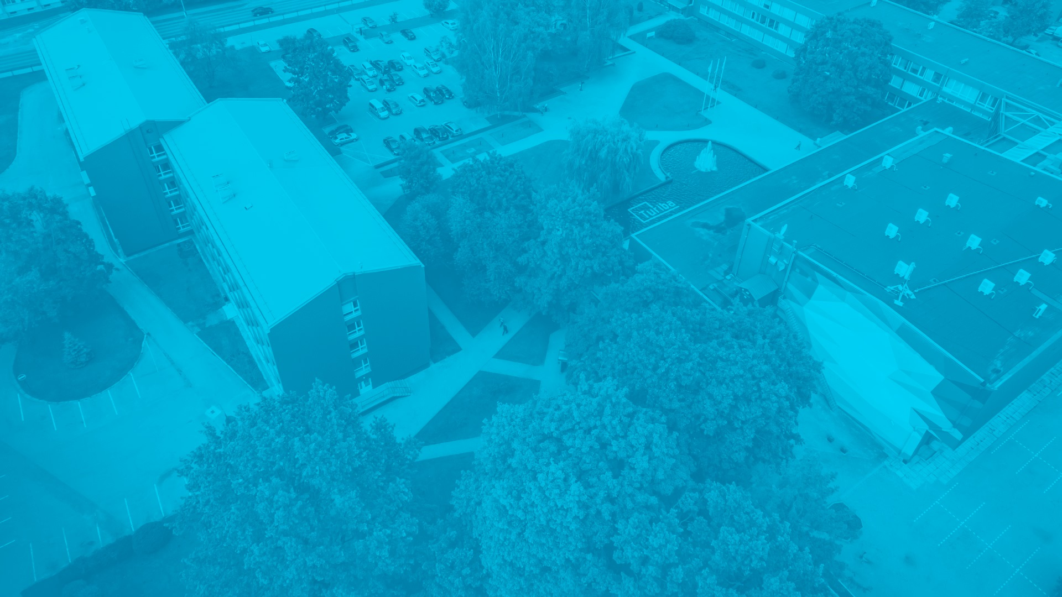




Turiba University
The largest private institution for higher education in the Baltics

Slide 2

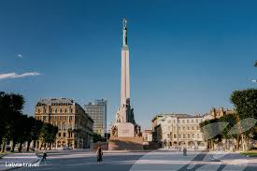
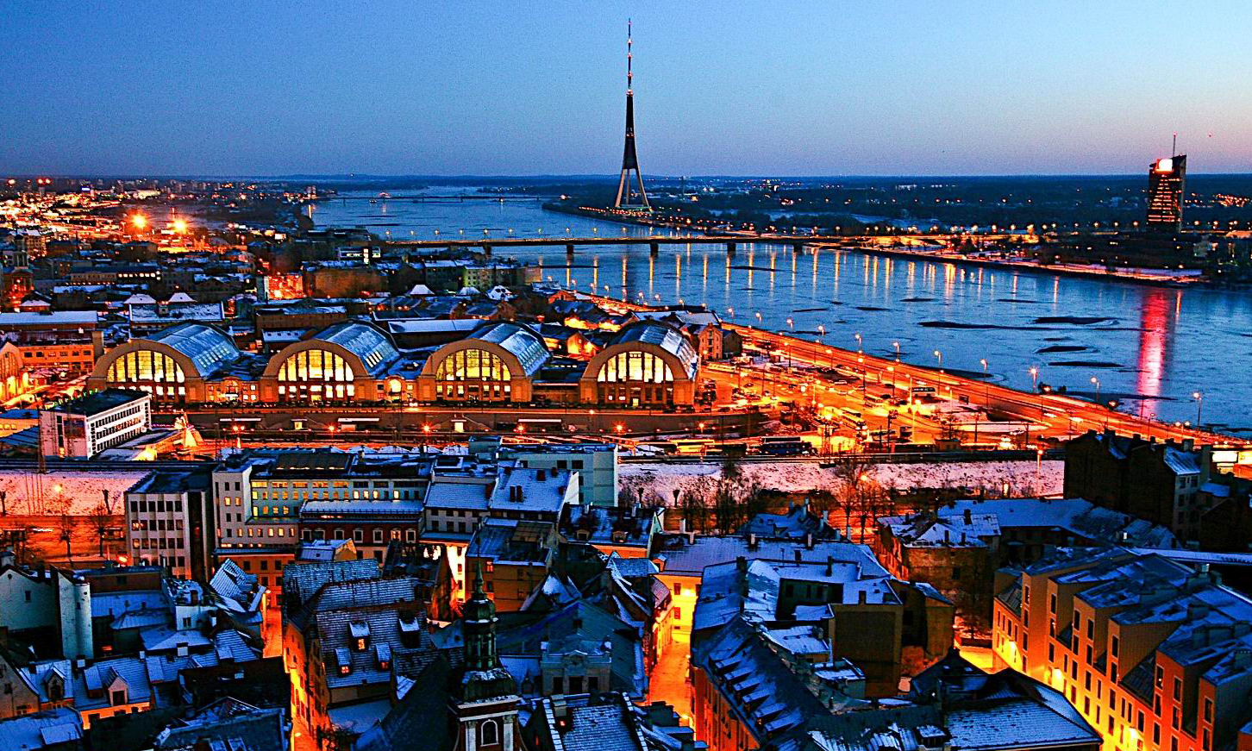
RIGA
Capital of Latvia – Rīga
Spread in 307 sq Km
627 487 inhabitants

Slide 3
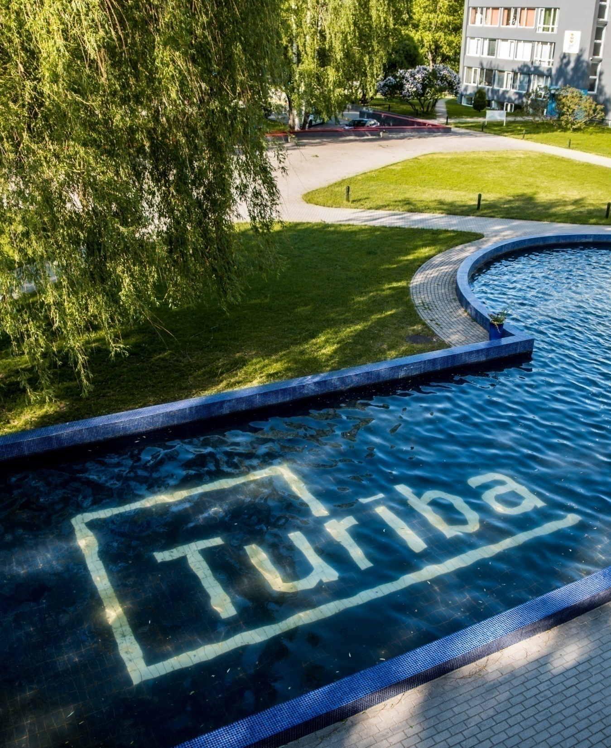
TURIBA UNIVERSITY
2020 marks the 27th anniversary for Turiba
Largest private institution for higher education
in the Baltics Located in Graudu Street, Rīga Latvia
Nearly 15,000 graduates
The most-sought after institution for foreign students: Turiba teaches young people
Nearly
3500 students
attain higher education in 2020
from more than 45 countries
worldwide

Slide 4

TURIBA STUDY PROGRAMS

Slide 5





TURIBA FACULTIES
Faculty of
Business Administration
Faculty
of Law
Faculty of
International
Tourism
Faculty of Communication
IT
Department

Slide 6
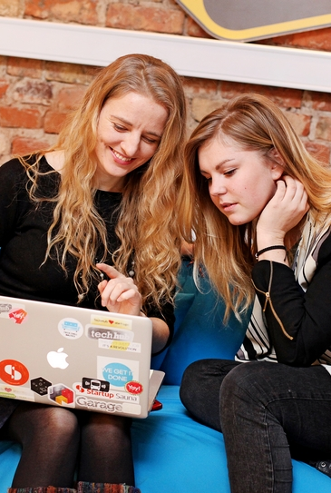


BACHELOR’S LEVEL
60% of academic time is devoted to practical studies – you can try your strength at a profession of your choosing, engage in practical work at the University and act out actual working processes
Business Administration
Business Logistics Management
International Financial Management
Tourism and Hospitality Management
Management of International Communication
Computer Systems
Turiba bachelors: practical skills and useful experience

Slide 7

MASTER’S LEVEL
Winning combination of theory and practical studies in a stable educational tradition
Business Administration, MBA
Business Psychology in HR Management
Strategic Tourism Management, MBA
Turiba masters: further education
for managing industry professionals

Slide 8


DOCTORAL STUDIES
Improve your competitive edge and break new ground
Business Administration
Legal Science
Communication Management
Turiba doctorate: reach new heights
in academics and research

Slide 9

LIVING AT TURIBA

Slide 10
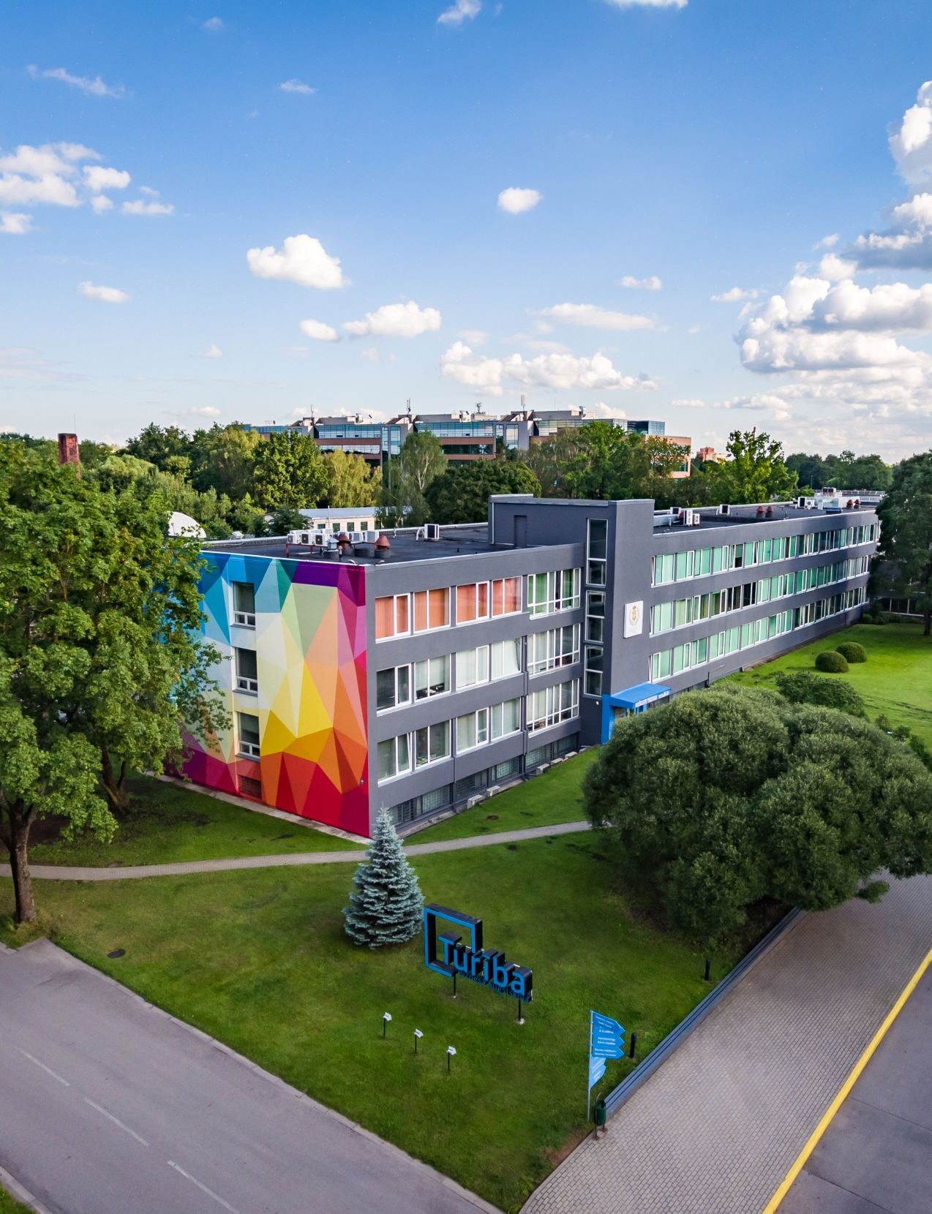
YOUTH HOSTEL
The Turiba campus has everything a student might need:
A hostel for 886 people on the Turiba premises
Spacious rooms
Quiet reading room
TV room
Computer rooms
Free Wi-Fi
Laundry
Hairdresser’s
Dentist
Sport facilities

Slide 11
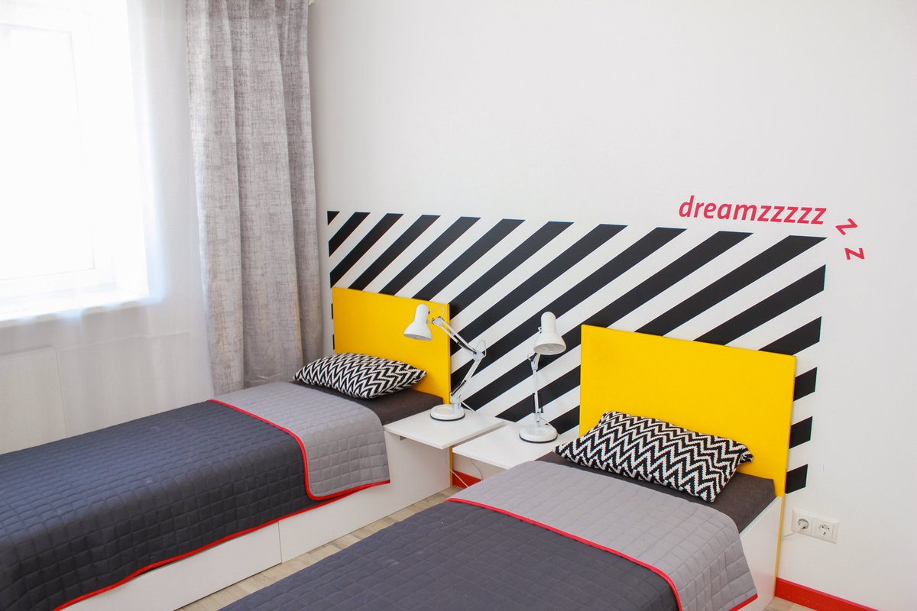
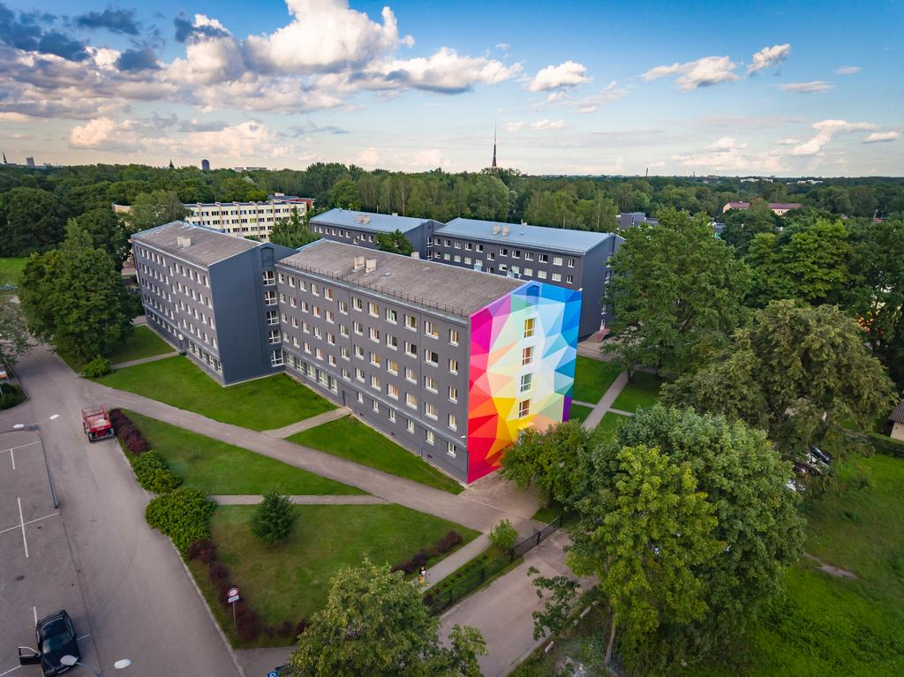
Accomodation and Cost of living
In Campus: starting from 67 EUR
Off Campus : starting from 180 Eur

Slide 12
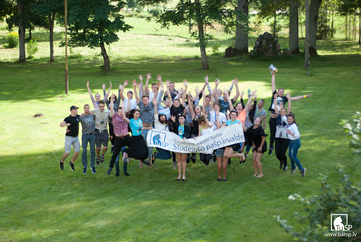
Students Council
Welcome Event
Gastronomy month
Cultural Events
Goodbye event
Buddy Programme

Slide 13
BUSINESS-CLASS EDUCATION
Turiba is a progressive, contemporary, international environment
Each study program includes business-oriented courses
60%
40%
practical knowledge and skills useful in life
theoretical studies
Stable position among the top 4 higher education institutions in Latvia recommended by employers
Over 80% of our current students are already working

Slide 14



INTERNATIONAL MEMBERSHIPS AND ACCREDITATIONS
Turiba University cooperates with organisations worldwide and have gained significant accreditations:
Collaboration with AACSB - global business education network and association that connects educators, students, and business to achieve a common goal: to create the next generation of great leaders.
Cooperation with EFMD - International management development network. EFMD raises educational business management quality, develops cooperation between enterprises and higher educational institutions.
UNWTO (United Nations World Tourism Organization) accreditation.

Slide 15
INTERNATIONAL OPPORTUNITIES
Double degree program
ERASMUS+ program
Bilateral exchange program
with institutions in
with institutions in
South Korea
USA
Mexico
Brazil
with over 100 partnering institutions
India
China
Peru
Georgia
France
UK
Turkey
Spain
Finland
Switzerland
Taiwan
Turiba international cooperation programs are
a way to learn about the international environment

Slide 16
www.turiba.lv
yashwant.jaiswal@turiba.lv exchange@turiba.lv
Biznesa.augstskola.Turiba
TuribaUniversity

