Slide 1
VAlencia
Universidad Europea de Valencia

Slide 2
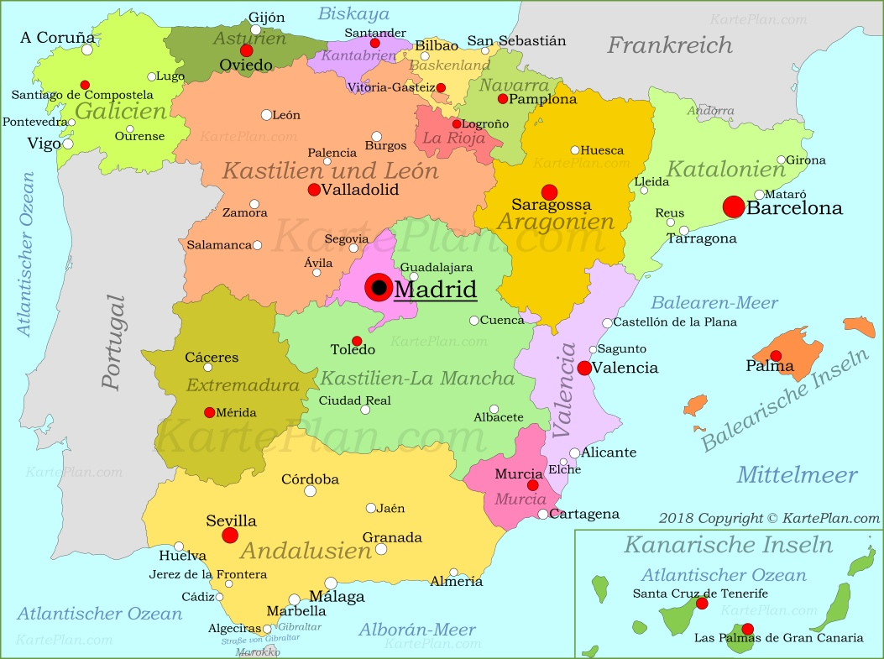

Slide 3
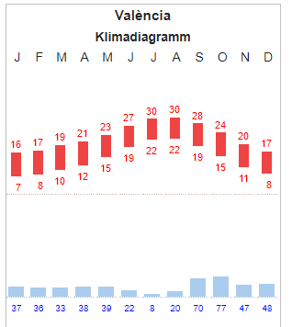
Facts about Valencia
Third biggest city in Spain
Habitants: 800k, Communidad 2 Mio.
6 universities
Almost 4000 international students every year
Languages: Spanisch and Valencian
You can also go skying in winter

Slide 4
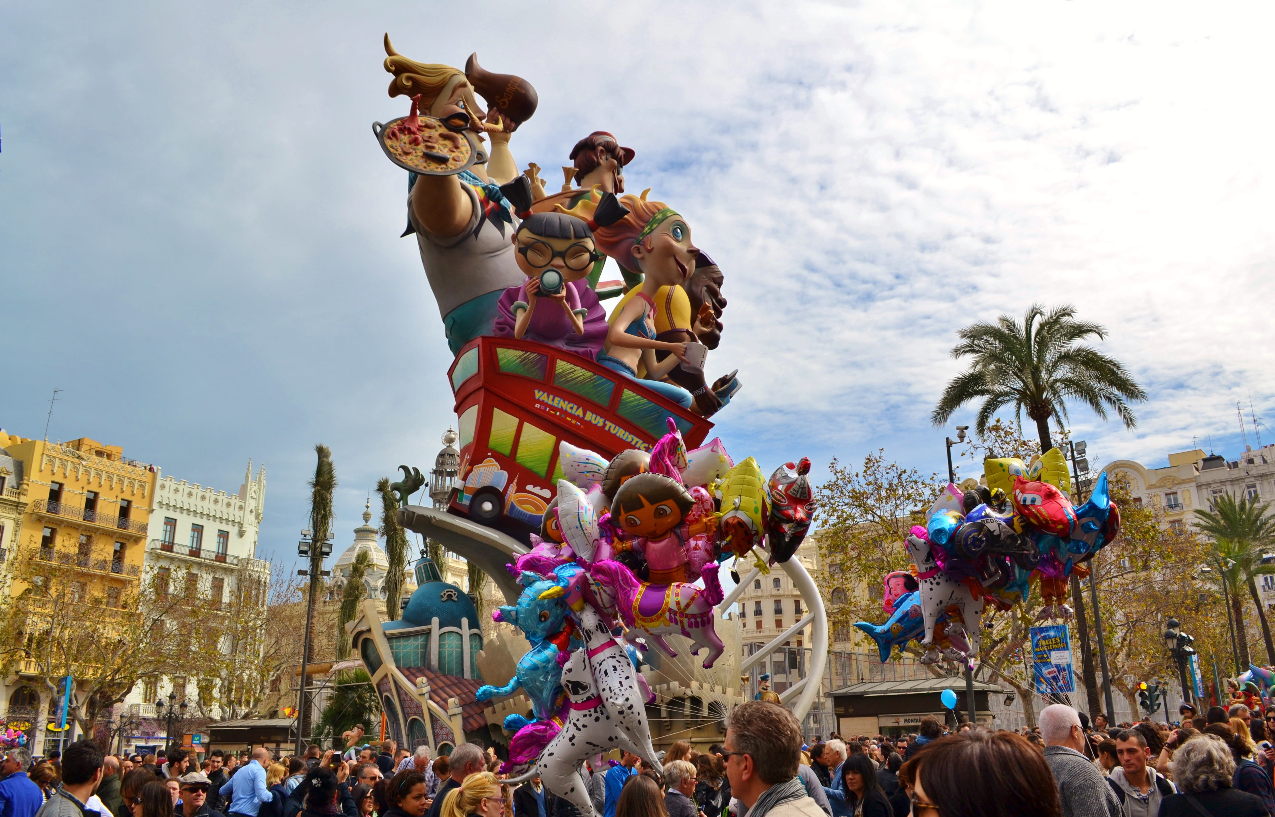
Culture
Fallas: One week of fiestas in March
Paella

Slide 5
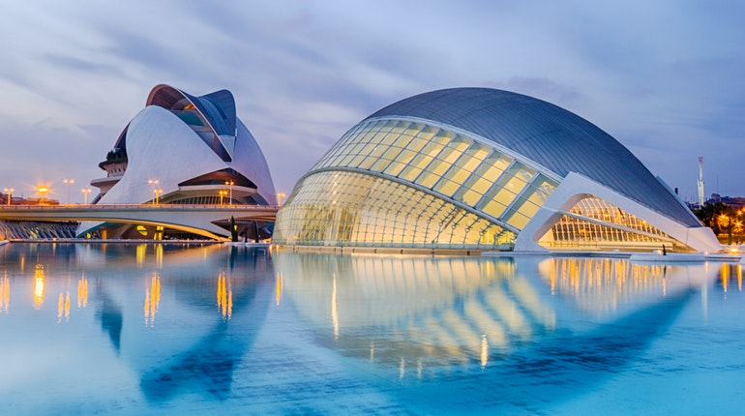
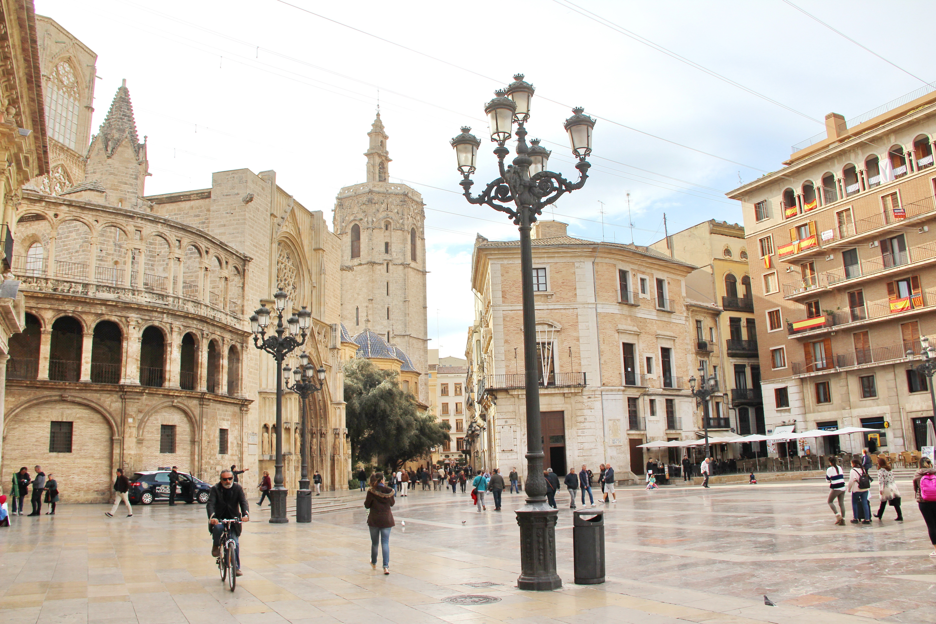
Ciudad de las artes y las ciencias
Albufera
Old town

Slide 6
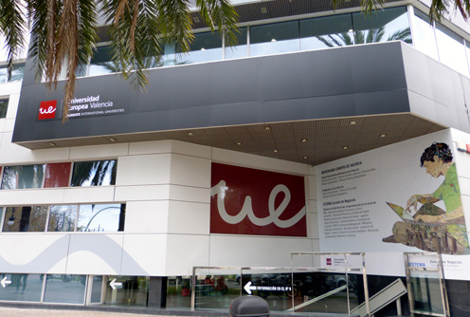
De Valencia
Private Uni, quite small
You DONT have to pay
You can choose between Spanish and English
4 courses (each 4 hours) , one spanish language course (2 hours)
Different system:
more homework, group work, presentations, case studies BUT exam only account for max. 60% of your grade (you may have mid-terms)
50% attendance
A great selection of courses!
If you have to repeat an exam it will be in July

Slide 7
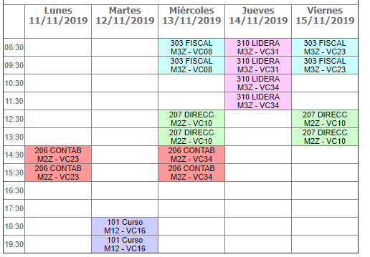
Schedules examples
TIP: Go to the office as soon as possible to organise your schedule
Semesters: September to January, January to June
No holidays in between but
Christmas
Fallas
Easter
And quite a lot of bank holidays

Slide 8
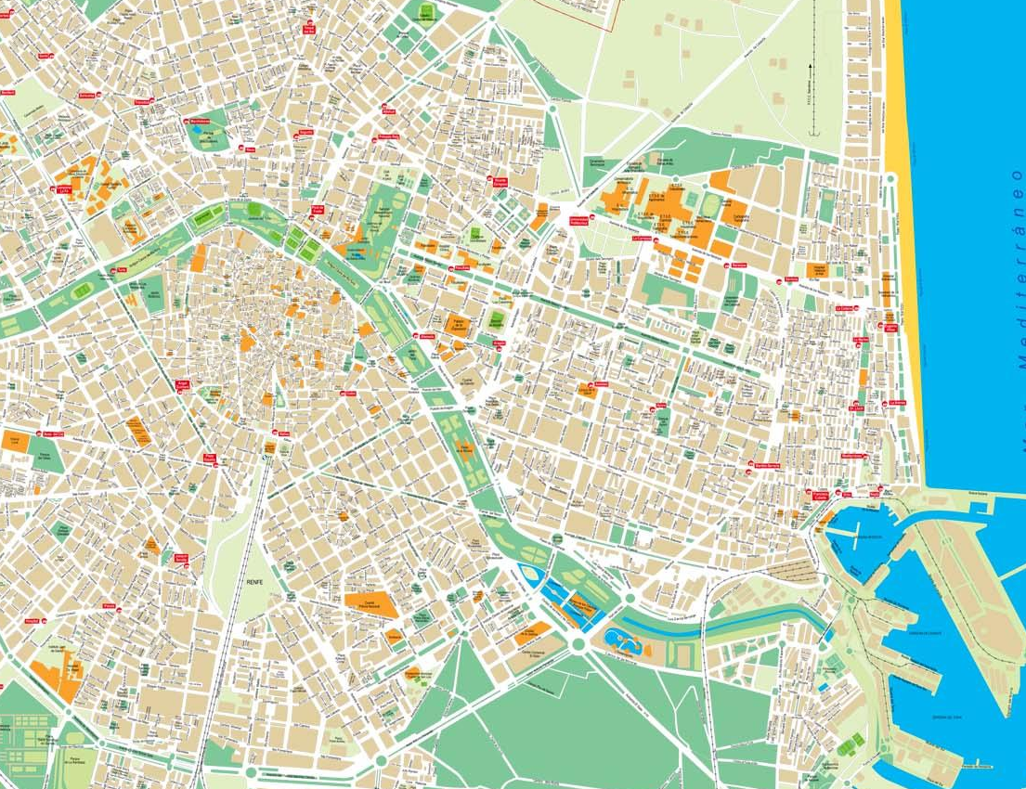
Our homes
From Leonie
To UEV
15/20 minutes by bike/metro
From Jan
→ To UEV
CITY CENTRE
UEV
Bars & Clubs

Slide 9
Room in a shared flat between 200€ and 350€ (if you want german standard you have to pay 300€ min)
Websites: Idealista, Facebook groups
Easy to find a room spontaneously
Be careful of agency fees!
Transport: Valenbisi, metro, bus (youth card), scooter
Food & Beverages are a bit cheaper
Maybe register yourself in your „centro de salud“, especially if corona is still on

Slide 10
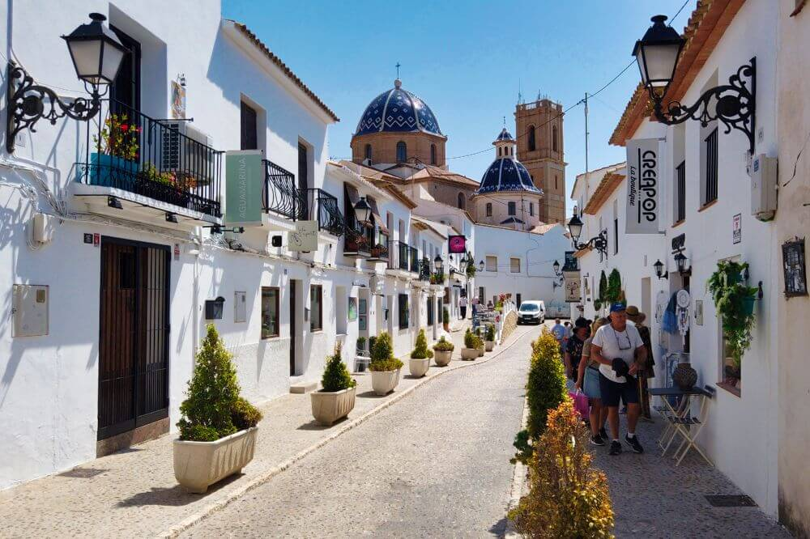
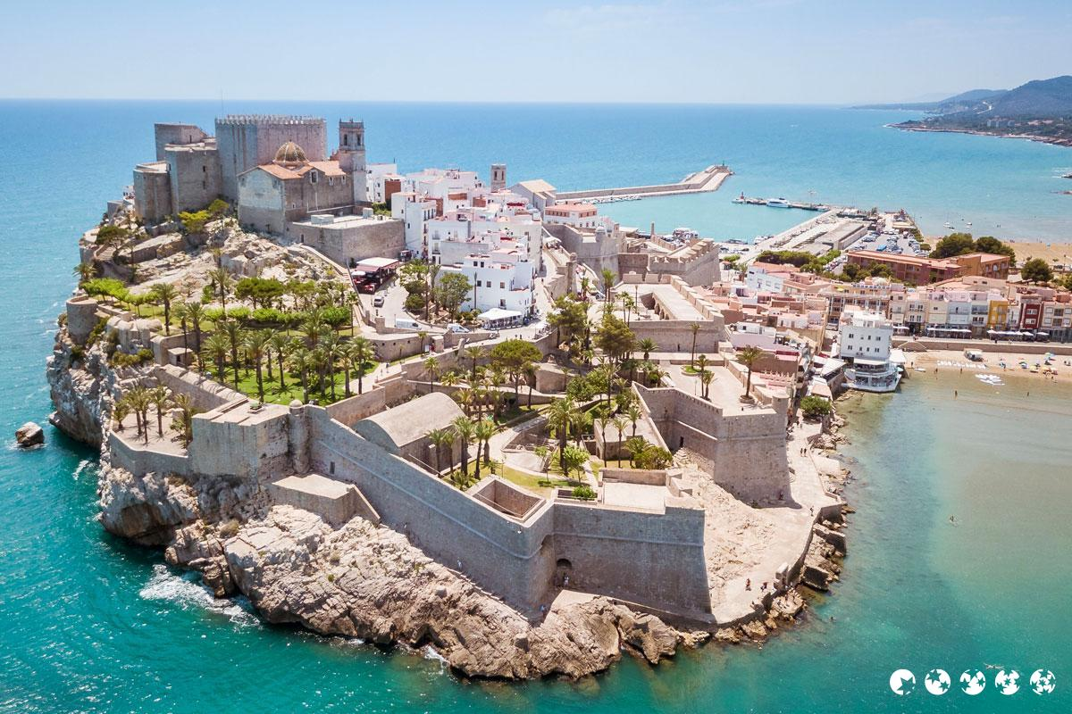
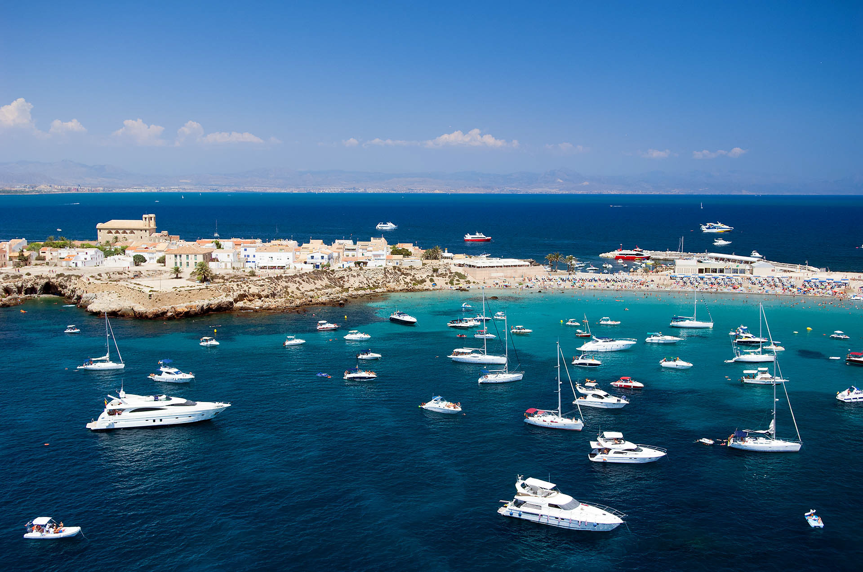
ERASMUS:
Loooots of activities, you can go to a party every evening if you want to
Also longer trips to: Barcelona, Madrid, Ibiza, Portugal etc
Daytrips to: Isla Tabarca, Altea, Peniscola

Slide 11
CONTACT INFOS
Leonie Peters
E-Mail: leoniepeters98@gmail.com
Jan Schüttert
E-Mail: janschuettert@gmx.de

