Slide 1

Progress of European integration
1952 ECSC
European Coal and Steel Community
1958 EEC and EURATOM
European Economic Community
European Atomic Energy Community
1967 EC
European Communities
1993 EU
European Union (Maastricht Treaty)
1998 ECB
Founding of the European Central Bank
2009 EU
Treaty of Lisbon

Slide 2
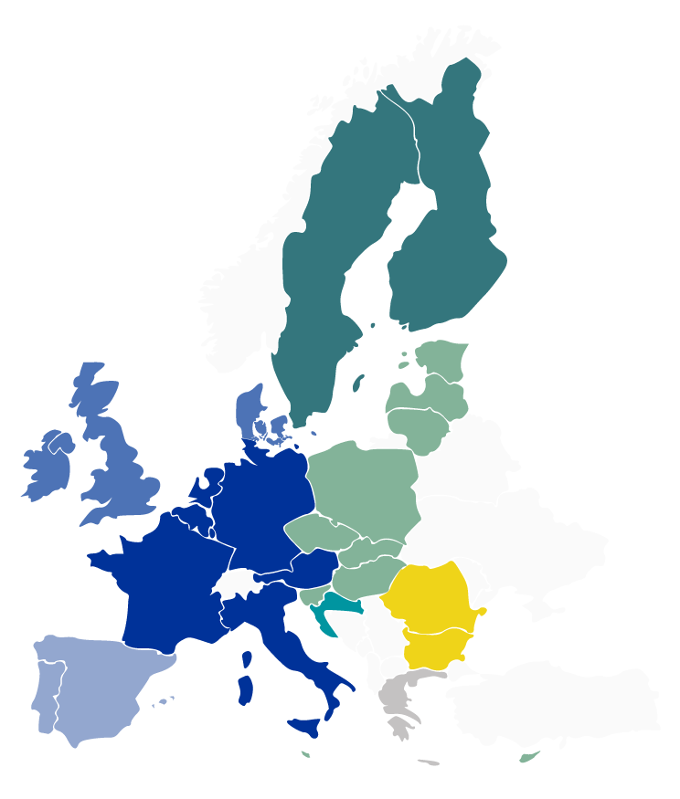
Enlargement of the European Union
1952 Belgium
Germany
France
Italy
Luxembourg
Netherlands
1973 Denmark
Ireland
United Kingdom
(left 2021)
1981 Greece
1986 Spain
Portugal
1995 Austria
Finland
Sweden
2004 Czech Rep.
Estonia
Cyprus
Latvia
Lithuania
Hungary
Malta
Poland
Slovenia
Slovakia
2007 Bulgaria
Romania
2013 Croatia
FI
SE
EE
DK
LV
LT
IE
NL
PL
UK
DE
BE
LU
CZ
SK
FR
AT
HU
SL
RO
IT
HR
BG
PT
ES
GR
MT
CY

Slide 3
Preparation of Economic and
Monetary Union (EMU)
1969 Barre Plan
1970 Werner Report
on economic and
monetary union
1979 EMS
European Monetary System
1986 Single European Act
1988 Delors Report
1998 Founding of the ECB
1999/2002 Introduction of the euro

Slide 4
Three stages to Economic and Monetary Union (EMU)
1 January 2002
Introduction of euro
banknotes and coins
3
1 January 1999
Irrevocable fixing of conversion rates,
ECB responsible for monetary policy
2
1 January 1994
Establishment of the European Monetary Institute,
the ECB’s predecessor
1
1 July 1990
Abolition of all restrictions
on the movement of capital

Slide 5

Convergence criteria
Economic and Monetary Union
Price stability
Interest rate convergence
Public finance discipline
Exchange rate stability

Slide 6
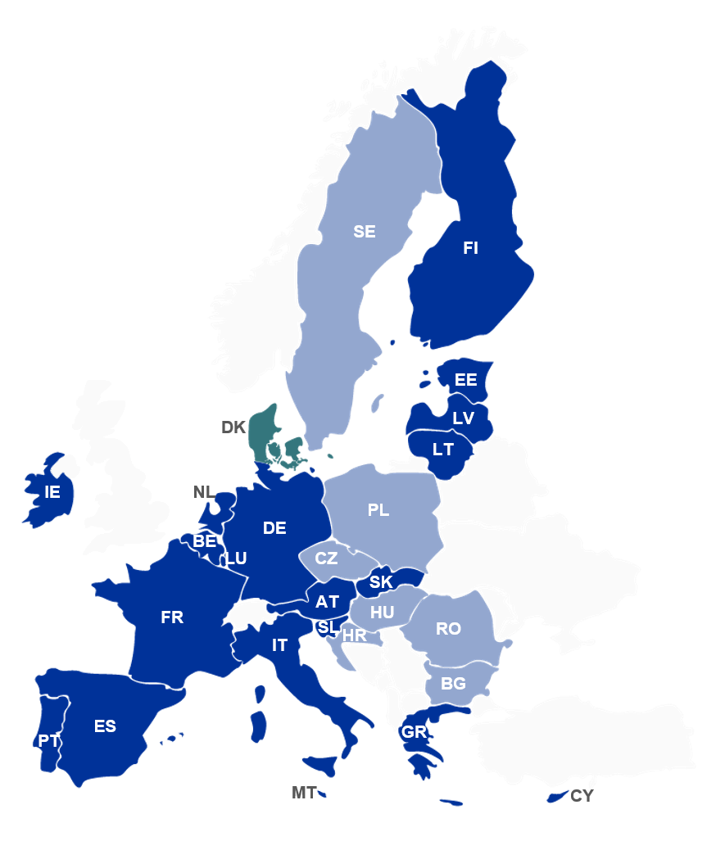
Economic and Monetary Union
(EMU)
EU Member States
which have adopted
the euro
EU Member States
with a special status
EU Member States
with a derogation
Notes:
Oder: https://asaphistorycom.files.wordpress.com/2020/02/582px-european_union_emu_map_en.png?w=582

Slide 7
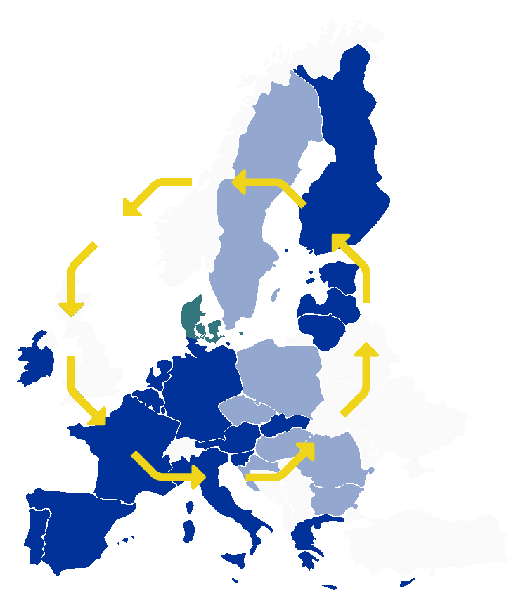
Financial integration of the euro area
Integration of financial markets,
financial infrastructures and
financial institutions
results in economies of scale, larger variety of financial products at lower cost
enhances transmission
of monetary policy impulses
contributes to safeguarding
of financial stability and
smooth operation of
payment systems

Slide 8
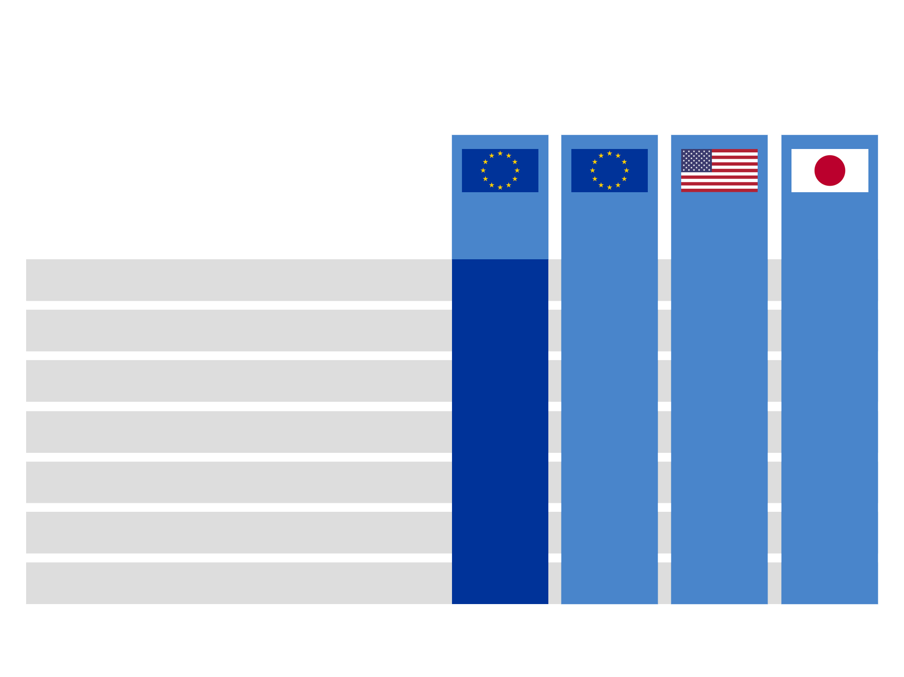

Key characteristics of the euro area
Reference year: 2020
€ -19
EU-27
343
14.7
42.9
12.1
45.4
21.9
23.5
448
18.3
40.8
15.1
46.7
21.9
21.9
329
19.1
57.9
15.8
10.1
18.9
19.3
126
4.9
38.6
4.0
15.5
25.5
26.8
1,411
22.1
15.7
18.3
18.5
43.5
44.5
Total population (millions)
GDP (PPP*, € trillions)
GDP per capita (PPP*, € thousands)
Share of world GDP (PPP*, %)
Exports (goods and services, % of GDP)
Gross fixed capital formation (% of GDP)
Gross saving (% of GDP)
Sources: for euro area and EU: ECB, Eurostat, national sources, IMF, World Bank and ECB calculations; for the United States, Japan and China: national sources, IMF, World Bank and ECB calculations. It covers data for the 19 countries in the euro area (i.e. including LT), EU-28 (i.e. including Croatia) and data for 2013 for all countries. The new ESA2010/SNA2008 methodology has been used except for Japan, which still uses the old SNA93.
* Purchasing Power Standards (PPSs) in euro, calculated on the basis of PPP rates relative to the euro area (Euro 19 = 1).
Notes:
https://ec.europa.eu/eurostat/databrowser/view/namq_10_pe/default/table?lang=en
https://databank.worldbank.org/reports.aspx?source=2&country=USA
https://databank.worldbank.org/reports.aspx?source=2&country=JPN
https://data.worldbank.org/country/china?view=chart
https://data.worldbank.org/indicator/NY.GDP.MKTP.PP.CD?end=2020&start=2005
https://ec.europa.eu/eurostat/databrowser/view/tet00003/default/table?lang=en
https://ec.europa.eu/eurostat/databrowser/view/tec00011/default/table?lang=en
https://www.theglobaleconomy.com/rankings/savings/#:~:text=Savings%20as%20percent%20of%20GDP,was%20in%20Lebanon%3A%202.47%20percent.
https://www.theglobaleconomy.com/rankings/savings/European-union/

Slide 9
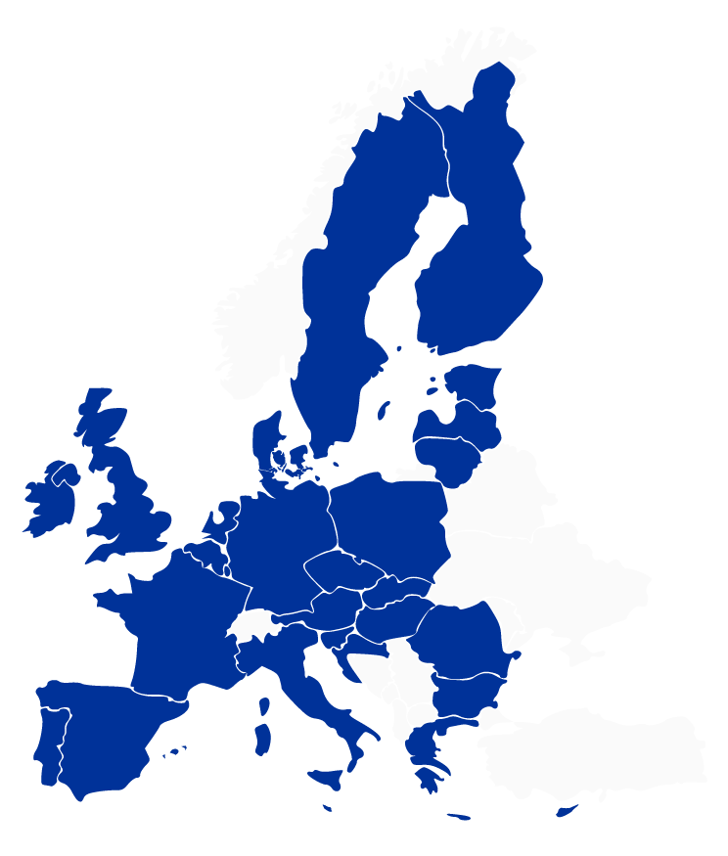
The European System of Central Banks (ESCB)
€ | European Central Bank
1 | Nationale Bank van België/
 | Banque Nationale de Belgique
2 | Българска народна банка
 | (Bulgarian National Bank)
3 | Česká národní banka
4 | Danmarks Nationalbank
5 | Deutsche Bundesbank
6 | Eesti Pank
7 | Central Bank of Ireland
8 | Bank of Greece
9 | Banco de España
10 | Banque de France
11 | Hrvatska narodna banka
12 | Banca d’Italia
13 | Central Bank of Cyprus
14 | Latvijas Banka
15 | Lietuvos bankas
16 | Banque centrale du
 | Luxembourg
17 | Magyar Nemzeti Bank
18 | Bank Ċentrali ta’ Malta/
 | Central Bank of Malta
19 | De Nederlandsche Bank
20 | Oesterreichische Nationalbank
21 | Narodowy Bank Polski
22 | Banco de Portugal
23 | Banca Naţională a României
24 | Banka Slovenije
25 | Národná banka Slovenska
26 | Suomen Pankki –
 | Finlands Bank
27 | Sveriges Riksbank
26
27
6
4
14
15
7
19
1
€
21
16
5
3
25
20
17
10
24
23
11
12
2
22
9
8
18
13

Slide 10
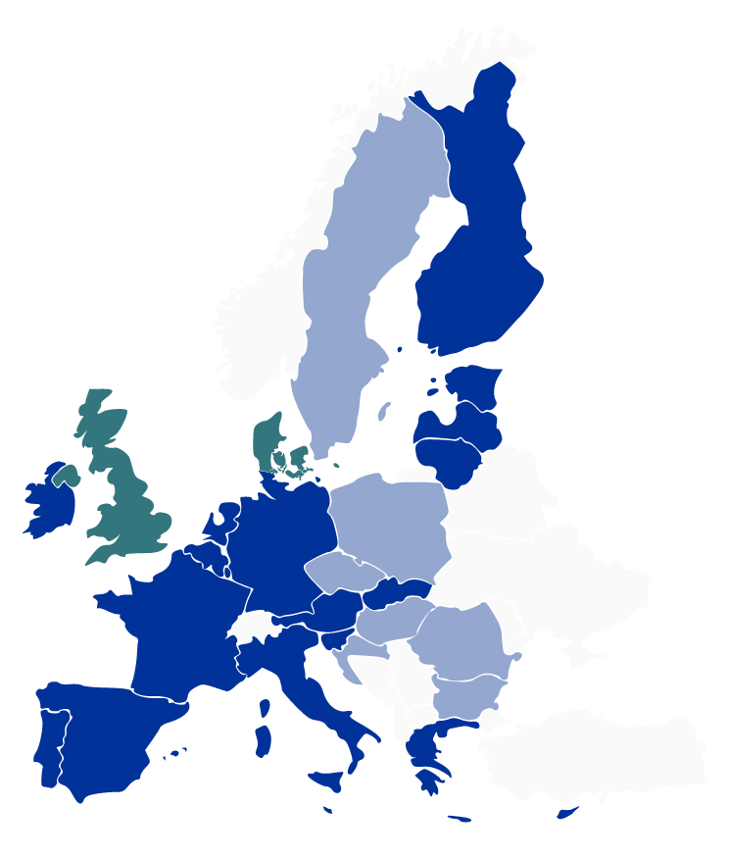
The Eurosystem
€ | European Central Bank
1 | Nationale Bank van België/
 | Banque Nationale de Belgique
2 | Deutsche Bundesbank
3 | Eesti Pank
4 | Central Bank of Ireland
5 | Bank of Greece
6 | Banco de España
7 | Banque de France
8 | Banca d’Italia
9 | Central Bank of Cyprus
10 | Latvijas Banka
11 | Lietuvos bankas
12 | Banque centrale du Luxembourg
13 | Central Bank of Malta
14 | De Nederlandsche Bank
15 | Oesterreichische Nationalbank
16 | Banco de Portugal
17 | Banka Slovenije
18 | Národná banka Slovenska
19 | Suomen Pankki – Finlands Bank
19
3
10
11
4
14
1
€
12
2
18
7
15
17
8
16
6
5
13
9

Slide 11
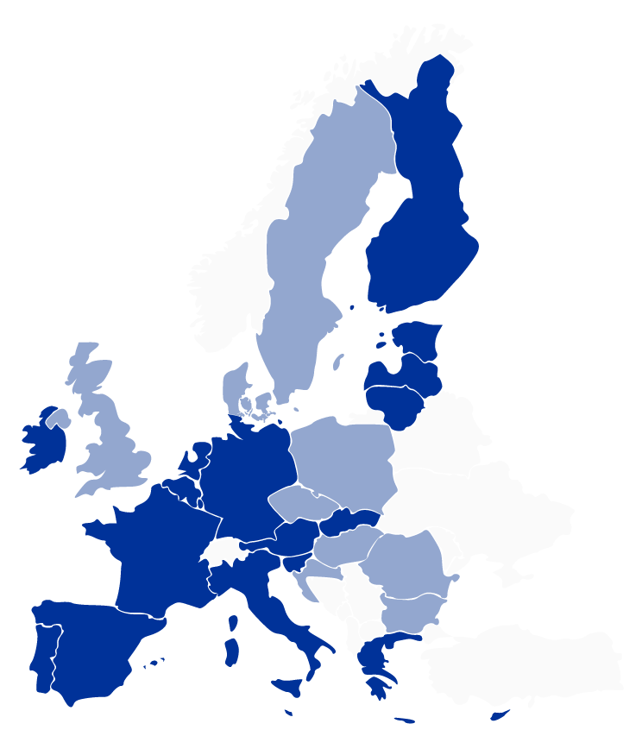
The NCBs as an integral part of the Eurosystem
Article 282 of the Treaty on the Functioning of the European Union:
“The European Central Bank, together with
the national central banks of the Member States whose currency is the euro, which constitute
the Eurosystem, shall conduct
the monetary policy of the Union.”
€
The Eurosystem
€
European
Central
Bank
National
central
banks

Slide 12
Key for subscription of the ECB’s capital
Euro area national central banks (NCBs)
Nationale Bank van België/ Banque Nationale de Belgique | 2.9630 %
Deutsche Bundesbank | 21.4394 %
Eesti Pank | 0.2291 %
Central Bank of Ireland | 1.3772 %
Bank of Greece | 2.0117 %
Banco de España | 9.6981 %
Banque de France | 16.6108 %
Banca d’Italia | 13.8165 %
Central Bank of Cyprus | 0.1750 %
Latvijas Banka | 0.3169 %
Lietuvos bankas | 0.4707 %
Banque centrale du Luxembourg | 0.2679 %
Bank Ċentrali ta’Malta/ Central Bank of Malta | 0.0853 %
De Nederlandsche Bank | 4.7662 %
Oesterreichische Nationalbank | 2.3804 %
1.9035 % | Banco de Portugal
0.3916 % | Banka Slovenije
0.9314 % | Národná banka Slovenska
1.4939 % | Suomen Pankki – Finnlands Bank
Non-euro area NCBs
0.9832 % | Българска народна банка
 | (Bulgarian National Bank)
1.8794 % | Česká národní banka
1.7591 % | Danmarks Nationalbank
0.6595 % | Hrvatska narodna banka
1.5488 % | Magyar Nemzeti Bank
6.0335 % | Narodowy Bank Polski
2.8289 % | Banca Naţională a României
2.9790 % | Sveriges Riksbank
Notes:
Daten aus 2021

Slide 13
Independence
Article 130 of the Treaty on the Functioning of the European Union:
“When exercising the powers and carrying out the tasks and duties conferred upon them by the Treaties and the Statute of the ESCB and
of the ECB,…
…neither the ECB, nor a national central bank,
nor any member of their decision-making bodies
shall seek or take instructions from Union institutions, bodies, offices or agencies, from any government of a Member State or from any other body.”

Slide 14

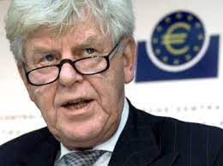

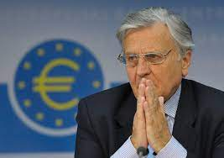

Accountability
Publications
Press conferences
Financial controls
Testimonies
before the European Parliament
Public speeches & interviews
Accounts of monetary policy discussions

Slide 15
Tasks of the EUROSYSTEM (1/2)
Basic tasks of the ECB and the EUROSYSTEM
Exchange operations
Monetary policy
Payment systems
Foreign reserves
To conduct foreign exchange operations
To define and implement monetary policy
To promote the smooth operation of payment systems
To hold and manage the official foreign reserves of the participating EU Member States

Slide 16
Tasks of the EUROSYSTEM (2/2)
Other tasks of the ECB and the EUROSYSTEM
Advisory functions
Collection and compilation of statistics
International cooperation
Issuance of banknotes
Contribution to prudential supervision and financial stability
Banking supervision

Slide 17
Tasks of the ECB (1/2)
Eurosystem policies
Monetary
policy
operations
Guidelines/
instructions
Banknotes
Forex markets
Payment systems
Conferred
by Treaty
Strategic planning, coordination and harmonisation
Operation
of systems
Definition
Deciding,
coordinating and
monitoring
Delegated
by EU Council
Intervention
(sometimes
jointly with
individual NCBs)
Oversight of financial market infrastructures and payment instruments
Monitoring
Foster integration
of financial market infrastructures and payment services

Slide 18
Tasks of the ECB (2/2)
Cooperation
Reporting
Financial risks
Advisory function
Operational hub for “ESCB systems”
ECB’s foreign reserve assets
International and European cooperation
Statutory reports
Community institutions
IT systems
Benchmarks for management by the NCBs
Monitoring
National
authorities

Slide 19
Tasks of the NCBs
Article 12.1 ESCB Statute:
“To the extent deemed possible and appropriate…the ECB shall have recourse to the national central banks to carry out operations which form part of the tasks of the ESCB [Eurosystem].”
Monetary policy
Foreign reserves
Payment systems
Banknotes
Collection of statistics
Execution of monetary policy operations
Management
Operation
of systems
Management and supervision of cash operations
Assistance
to ECB
Own
ECB
Oversight of financial market infrastructures
and payment instruments

Slide 20
Decision-making bodies of the ECB
The Governing Council is the main decision-making body of the ECB.
It consists of the six members of the Executive Board, plus the governors of the national central banks of the 18 euro area countries.
The Executive Board consists of the President of the ECB, the Vice-President and four other members.
General Council
The General Council comprises the President of the ECB, the Vice-President and the governors of the national central banks (NCBs) of the 28 EU Member States.
The Supervisory Board comprises a Chair, a Vice-Chair, four ECB representatives and representatives of national supervisors.

Slide 21

Governing Council
Adopts guidelines and
decisions to ensure the
tasks of the Eurosystem
are performed
Formulates
monetary policy
  Key ECB interest rates
Liquidity
Governing Council
Genera Council

Slide 22

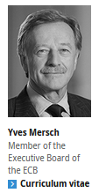

Executive Board
Implements the monetary policy of the ECB
Prepares meetings of the Governing Council
Conducts the day-to-day business
of the ECB
Governing Council

Slide 23
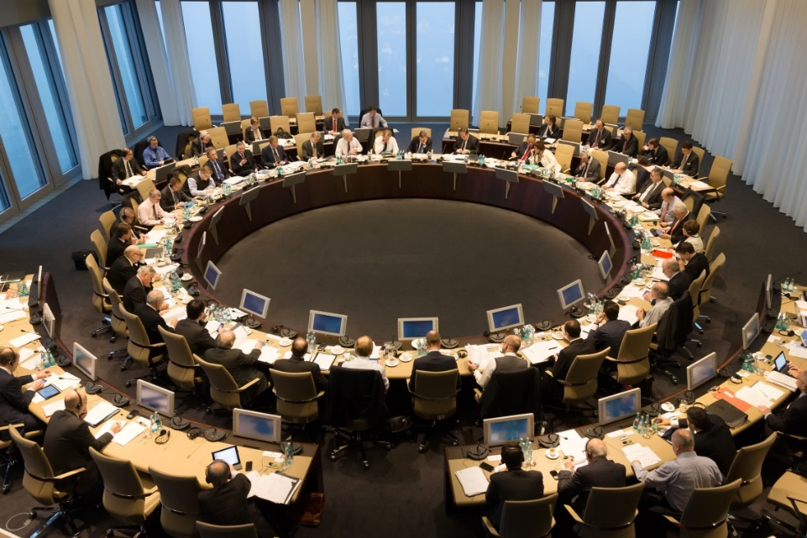
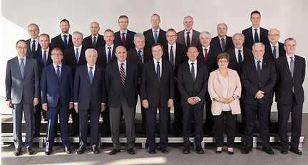
General Council
Reports on convergence
Contributes to
  the advisory functions of the ECB
the collection of statistical data
the reporting activities of the ECB
the laying-down of the conditions of employment of the staff of the ECB
Governing Council
The General Council comprises
the President of the ECB;
the Vice-President of the ECB;
the governors of the national central banks (NCBs) of the 27 EU Member States.

Slide 24


Price stability – Objective of the Eurosystem
Article 127 of the Treaty on the Functioning of the European Union:
“1. The primary objective of the ESCB [Eurosystem] shall be
to maintain price stability.
Without prejudice to the objective of price stability, the ESCB [Eurosystem] shall support the general economic policies in
the Union with a view to contributing to the achievement of the objectives of the Union as laid down in Article 3 of the Treaty
on European Union.”

Slide 25
Price stability – Definition
Governing Council in October 1998:
“Price stability shall be defined as
a year-on-year increase in the
Harmonised Index of Consumer
Prices (HICP) for the euro area
of below 2%. Price stability is to be
maintained over the medium term.”
The Governing Council aims
to maintain inflation rates at levels
below, but close to, 2% over
the medium term.

Slide 26
Benefits of price stability
Price stability contributes to
Recognising changes in relative prices
The productive use
of resources
Maintaining social
cohesion and stability
Avoiding “inflation
risk premium”
Reducing the distortionary
impact of tax and
social security systems
Financial
stability

Slide 27
The ECB’s monetary policy strategy
Primary objective: price stability
Governing Council
takes monetary policy decisions
based on an overall assessment
of the risks to price stability
Economic analysis
cross-checking
Monetary analysis
Analysis of economic
dynamics and shocks
Analysis of
monetary trends
Full set of information

Slide 28
Monetary policy strategy – Economic analysis
Analysis of a broad range of economic/financial developments
Supply
Demand
Goods, services, factor markets
to assess
Economic shocks
Dynamics
Perspectives

Slide 29
Monetary policy strategy – Monetary analysis
Analysis of monetary and credit developments
Identification of financial imbalances and/or asset price bubbles
Long-run link between
money and prices
in the euro area
Money as medium to
long-term benchmark

Slide 30
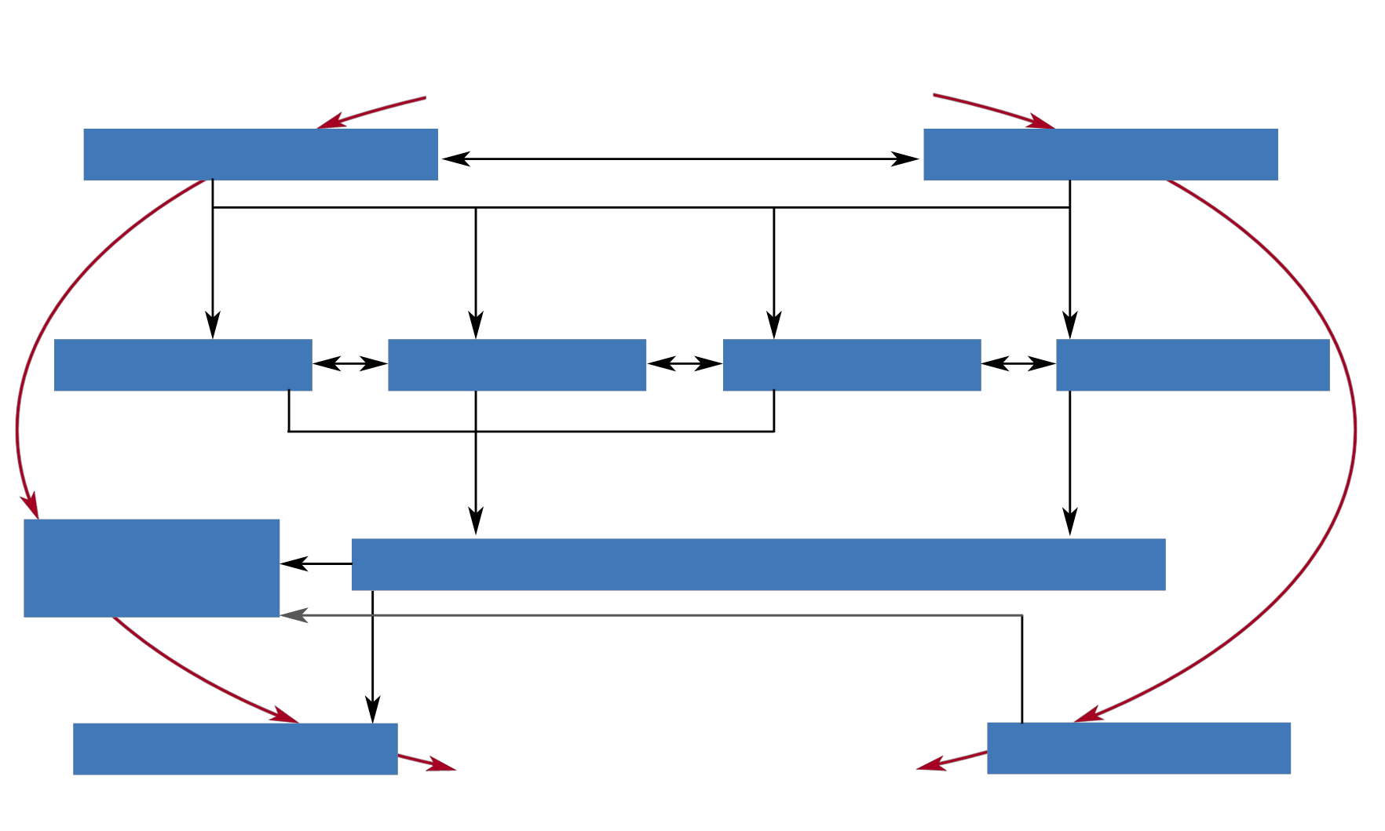
Transmission mechanism –
How interest rates affect prices
Official interest rates
Expectations
Money market rates
Money, credit
Asset prices
Bank rates
Exchange rates
Wage and
price-setting
Supply and demand in goods and labour markets
Domestic prices
Price developments
Import prices

Slide 31
Key characteristics of a successful monetary policy
When it takes its monetary policy decisions, the Governing Council seeks to influence conditions in the money market.*
Monetary policy aims to
preserve the functioning of the transmission mechanism
be forward-looking and pre-emptive
focus on the medium term
firmly anchor inflation expectations
be broadly based.
* In normal times the level of short-term interest rates can be set so as to ensure that price stability
is maintained over the medium term.

Slide 32
The monetary policy instruments
Standing facilities
Open market operations
Reserve requirements
Deposit
facility
Marginal
lending
facility
Main refinancing operations
Reserve base
Deposits, debt securities
and money market paper
(Rates generally
lower than
market rates)
(Rates generally
higher than
market rates)
(Maturity: one week)
Reserve ratio
For the majority of
the items to which the
reserve base applies
Longer-term refinancing
operations
Asset purchase programmes
Fine-tuning operations
Remuneration
Reserve holdings will be
remunerated at the
Eurosystem’s rate on its
main refinancing operations
Pandemic emergency
purchase programme (PEPP)
Structural operations
> https://www.ecb.europa.eu/mopo/implement/html/index.en.html

