Slide 1
The value of second-hand branded SUV cars in the German market.
An application of the Hedonic Pricing Approach.
TEAM 4
Johann Reichmann
Mohammad Ataur Rahman
Kishore Patnaik
Luis F. Quiceno
Anuja Shedbale
Ramitha Ravi
Shruthi Ravichandran
Course : MBA in Global Management
University: Hochschule Bremen
Module: Quantitative Methods
Date: 12.04.2019

Slide 2
TABLE OF CONTENTS
Topic and motivation
Research Question and Hypothesis
Assumptions and Limitations
Descriptive statistics about the variables
Simple regressions, results and graphs
Multiple Regressions
Hypothesis Testing
Conclusions and Recommendations
Video and price calculators
References

Slide 3
1.Topic and Motivation

Slide 4
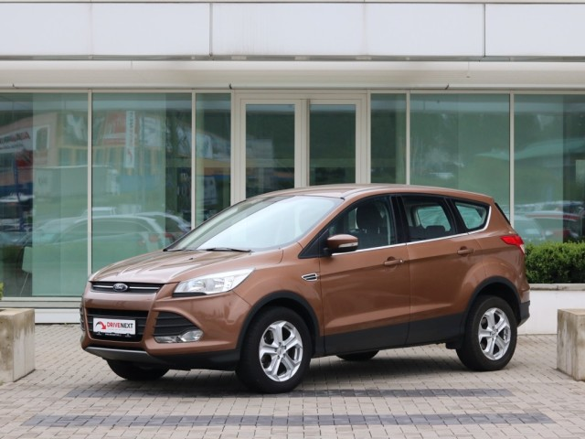
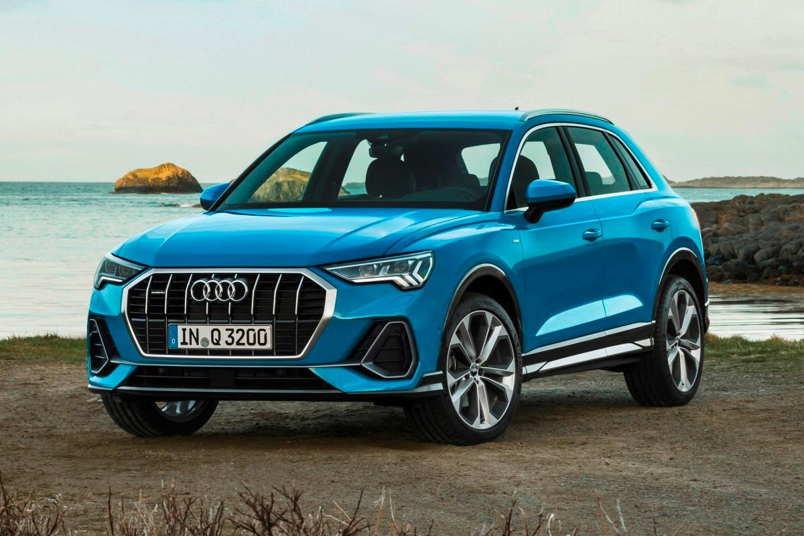
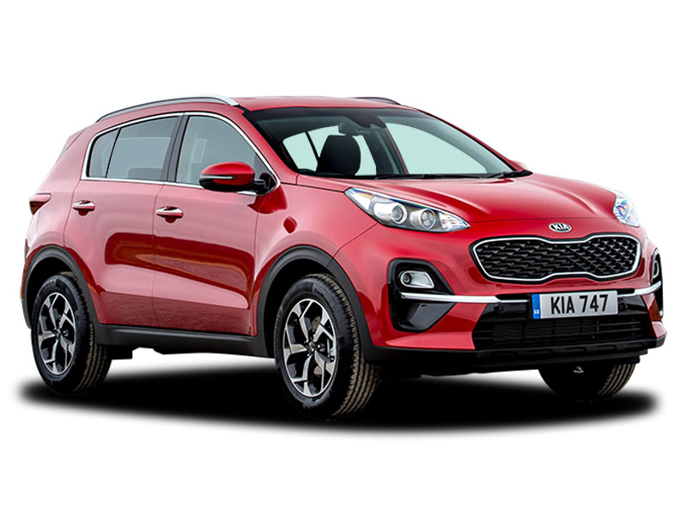
1. Topic and Motivation
How are the prices of used cars determined in German Market ?
As International students living in a foreign country, most of us are planning in making a life in Germany.
After buying a house, what is the second biggest investment you can make?
3 different Brands but similar models will be compared.
How did we choose this models? We decided on working with Midsized SUV-Sport Utility Vehicle, because it is the fastest growing segment of cars.

Slide 5
1. Topic and Motivation
3 brands observed for this project,each from a different continent, Audi(Q3), Ford(Kuga), KIA(Sportage)
Observations where made on March 27, 2019 from www.mobile.de website
8 variables :
Price
Kilometers
CCM (Cubic centimeters)
HPs (Horsepowers)
Age
Transmission
Fuel
Brand

Slide 6
2. Research Question and Hypothesis

Slide 7
2.Research Question
How do the variables Brand, Kilometers and Age affect the price of a second-hand car in the German market?

Slide 8
Comment:
At this point you could ideally present and discuss some results from your literature research. Which opinions did you find there / which results concerning your research question? You will find most of the information you need in the abstracts of the papers, but of course sometimes you have to find the parts of the literature where your questions are discussed.
From this you can derive the hypotheses for your own empirical study.

Slide 9
2. Hypotheses
H01: Brand of Audi affects the price in a bigger way than other
brands in the German Market.
H02: Brand of Audi affects the price in a lesser way than other
brands in the German Market.
H03: Higher number of kms the car has driven depreciates the price of the car.
H04: Higher number of kms the car has driven appreciates the price of the car.
H05: The older the car lower the price of the car.
H06: The older the car higher the price of the car.
Comment:
It doesn’t make a lot of sense to have these pairs of hypotheses. At the end, these are only three hypotheses. (you could differentiate between H₀ and H_{A} (for “alternative”) for all three hypotheses, so you’d end up with H₀₁ and H_{A1} , …, H₀₃ and H_{A3} – but still: what’s the point of doing this??)
Better: Also present hypotheses about the dummy variables example: H₀₄: An automatic transmission increases the value of a car …

Slide 10
3. Assumptions and limitations

Slide 11
3. Assumptions and limitations
The offered prices on the website by individuals are reliable for the value represented.
This study is limited to the models of cars used in this analysis in the German Market as of March 27, 2019.

Slide 12
4. Descriptive Statistics about the Variables

Slide 13
4. Descriptive statistics about the variables
Dependent Variable :
Price – Resale value (offer price) of cars.
Independent Variables :
1. Non-Dummy Variables :
Kilometers – Total running of the cars in kms.
CCM ( Cubic centimeters)- Volume of the car engine.
HPs ( Horsepowers) - The power produced by the car engine.
Age – Number of years used.
2.Dummy Variables :
Transmission – Automatic or manual.
Fuel – Diesel or petrol.
Brand – Ford and Audi.

Slide 14
4. Descriptive statistics about the variables

Slide 15
4. Descriptive statistics about the variables
Comment:
Better also add the number of observations, the other means (median and mode), …

Slide 16
x. Correlations
Comment:
This could be an own numbered title, but even better it can be another subpoint of 4
The best way to show correlations is using the “correlations” table from the analysis tools in Excel
(example from Koop):
And of course don’t forget the interpretation of the correlations: What do we learn (for the coming regression analyses)?
 | Sale Price | Lot size | #bed | #bath | #storey
Sale price | 1
Lot size | 0.5358 | 1
#bed | 0.3664 | 0.1519 | 1
#bath | 0.5167 | 0.1938 | 0.3738 | 1
#storeys | 0.4212 | 0.0837 | 0.4080 | 0.3241 | 1

Slide 17
5. Simple Regressions, Results and Graphs

Slide 18
5. Simple Regressions, Results and Graphs

Slide 19
5. Simple Regression, Results and Graphs

Slide 20
6. Multiple Regressions

Slide 21
6. Multiple Regressions
(Analysis of variables)

Slide 22
6. Multiple Regressions
(Selected variables)

Slide 23
6. Multiple Regressions
(Formula)
Y= A+ (B1*D1)+(B2*D2)+(B3*X1)+(B4*X2)+(B5*X3)
A= Alfa (intercept), B= Beta (coefficient), D= dummy variable, X=metric variable
Car´s Price= Intercept+ (Automatic Coefficient*(1 or 0))+(Audi Coefficient*(1 or 0))- (Km Coefficient*Kms)+ (HP Coefficient*HPs)-(Age coefficient*years)
Car´s Price= 15.536,48+ (1.477,64*(1 or 0))+(3.878,61*(1 or 0))- (0,04*Kms)+ (48,06*HPs)-(1.010,19*years)

Slide 24
7. Hypothesis Testing

Slide 25
7. Hypothesis testing
H01: Brand of Audi affects the price in a bigger way than other
brands in the German Market. Accepted
H02: Brand of Audi affects the price in a lesser way than other
brands in the German Market. Rejected
H03: Higher number of kms the car has driven depreciates the price of the car. Accepted
H04: Higher number of kms the car has driven appreciates the price of the car. Rejected
H05: The older the car lower the price of the car. Accepted
H06: The older the car higher the price of the car. Rejected

Slide 26
8. Conclusions and Learnings

Slide 27
8. Conclusions and Learnings
The price of second-hand cars in the German Market is influenced significantly by Brand, Kilometers and Age. In addition, its price is affected by type of transmission and HPs.
The influence of Cubic Centimeters and Fuel in the price of second-hand cars in the German Market is insignificant.
When Price of second-hand cars is evaluated, not only quantitative variables are needed, indeed, qualitative variables including dummies must be considered.
Previous studies and common sense must be combined in order to identify the possible variables to be used when a Hedonic Pricing Approach is applied.

Slide 28
Video and Price Calculators
Video
https://www.webuyanycar.com/car-valuation/how-does-car-mileage-affect-value/
https://www.youtube.com/watch?v=0ZtgJDisRf4
Price calculators
https://www.webuyanycar.com/carvaluation/
https://www.edmunds.com/appraisal/

Slide 29
Comment:
The quotations are chiefly correct but the “retrieved from” is not usual for journals. If you quote webpages, you have to add the URL and the date of access.
References are not numbered, but just sorted alphabetically.
References
Cooper, D., Schindler, P.S. (2013). Business Research Methods . New York, United States: McGraw-Hill/Irwin.
Cowling, K., Cubbin J., (1972).Hedonic Price indexes for United Kingdom cars. The Economic journal ,82(327) ,963-978. Retrieved from https://www.jstor.org/stable/2230261?seq=1 - metadata_info_tab_contents.
Koop, G. (2005). Analysis of Economic Data, West Sussex, England: John Wiley & Sons Ltd.
Matas, A., Raymond J.,(2009).Hedonic Prices for cars: an application to the Spanish Car market,1981-2005.Applied Economics of Transport, 41(22),2887-2904. Retrieved from https://www.tandfonline.com/doi/abs/10.1080/00036840701720945.
Mobile.de (2019). Car offers (data). https://www.mobile.de, last access: 20 March 2019 22:00
Murray, J., Sarantis, N.,(1999). Price-Quality Relations and Hedonic Price Indexes for cars in the united kingdom. International Journal of the Economics of Business, 6(1), 5-27. Retrieved from https://www.tandfonline.com/doi/abs/10.1080/13571519984287.

Slide 30
THANK YOU!

